Slide 1
Codependency
Johnené Vardiman-Ditmanson, MS, LCDC, SAP

Slide 2
Disclosures
The material presented today is my own personal opinion and experience. This presentation should not be considered the opinion of the University of Texas Medical Branch (UTMB).
I have no financial interests to disclose.

Slide 3
Definition
Codependency is a type of dysfunctional helping relationship where one person supports or enables another person's drug addiction, alcoholism, gambling addiction, poor mental health, immaturity, irresponsibility, or under-achievement. Among the core characteristics of codependency, the most common theme is an excessive reliance on other people for approval and a sense of identity. ¹

Slide 4
Codependency
Codependent relationships are marked by intimacy problems, dependency, control (including caretaking) denial, dysfunctional communication and boundaries, and high reactivity. Often, there is imbalance, so one person is abusive or in control or supports or enables another person's addiction, poor mental health, immaturity, irresponsibility, or under-achievement. ²
Some codependents often find themselves in relationships where their primary role is that of rescuer, supporter, and confidante. These helper types are often dependent on the other person's poor functioning to satisfy their own emotional needs.¹ Many codependents place a lower priority on their own needs, while being excessively preoccupied with the needs of others. Codependency can occur in any type of relationship, including family, work, friendship, and also romantic, peer or community relationships. ³

Slide 5
Symptoms
intense and unstable interpersonal relationships
inability to tolerate being alone, accompanied by frantic efforts to avoid being alone
chronic feelings of boredom and emptiness
subordinating one's own needs to those of the person with whom one is involved
overwhelming desire for acceptance and affection
perfectionism
over-controlling
external referencing
dishonesty and denial
manipulation
lack of trust
low self-worth ⁴

Slide 6
Clinical Criteria for Codependence?
In 1980 Timmen Cermak, M.D. proposed that Codependency be considered a personality disorder and be included in the DSM-III. Although he was unsuccessful in obtaining approval for inclusion in the DSM his criteria could be valuable for clinicians.
Continued investment of self-esteem in the ability to control both oneself and others in the face of serious adverse consequences.
Assumption of responsibility for meeting others' needs to the exclusion of acknowledging one's own.
Anxiety and boundary distortions around intimacy and separation.
Enmeshment in relationships with personality disordered, chemically dependent, other co ‐ dependent, and/or impulse ‐ disordered individuals.
Three or more of the following:
  Excessive reliance on denial
  Constriction of emotions (with or without dramatic outbursts)
  Depression
  Hypervigilance
  Compulsions
  Anxiety
  Substance abuse
  Has been (or is) the victim of recurrent physical or sexual abuse
  Stress ‐ related medical illnesses
  Has remained in a primary relationship with an active substance abuser for at least two years without seeking outside help. ⁴

Slide 7
Hallmark Traits
Denial
Low-Self Esteem
Compliance
Control
Avoidance ³

Slide 8
Theories
Family Systems Theory – Must examine and heal the primary environment (family ecosystem) to create a healthy, supportive recovery.
Attachment Theory – Must identify unhealthy attachments and create new sense of self and needs to be well.
Social Learning Theory – Must investigate unhealthy, learned behavior and create new ways of coping. Learned behaviors can be passed along to other generations.
Cognitive-Behavioral Therapy – Must identify unhealthy cognitive patterns and alter the way to thinking that drives behavior. Healthier thought patterns lead to healthier behavioral choices.

Slide 9
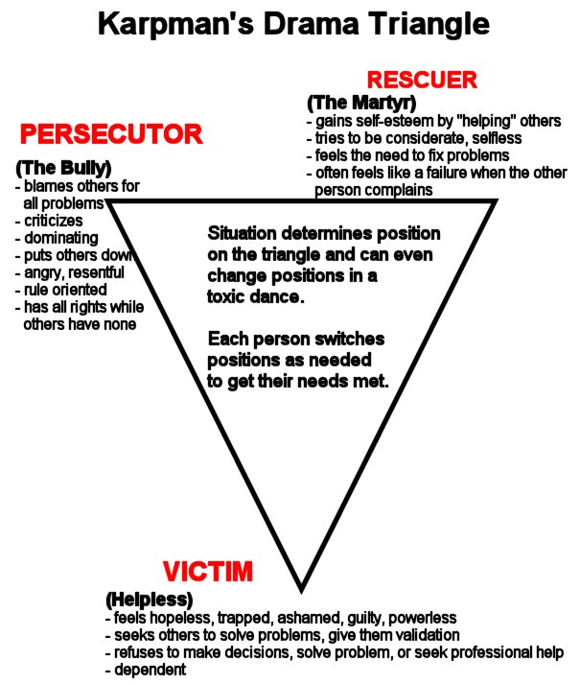

Slide 10
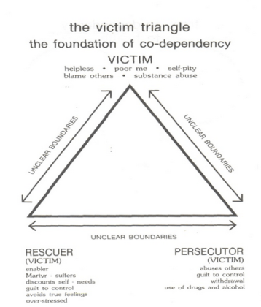

Slide 11
Generational Family Dysfunction Cycle
Children depending on those who are undependable
Found in children who experienced addiction, neglect, abuse, or other childhood trauma
Children acquire social and emotional habits for survival
  Caretaking, scapegoating, controlling, people-pleasing, approval seeking, etc.
Untreated adults can often develop addictive disorders themselves and be attracted to similar/familiar patterns in relationships as adults

Slide 12
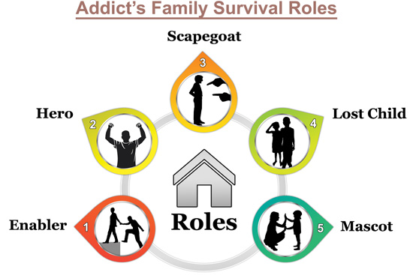
Dysfunctional Family Roles

Slide 13
How can codependency hinder recovery?
Sabotage
Undermining
Enabling old habits
Return to people, places and things

Slide 14
Recovering from Codependency
Become educated on codependency
Take an honest assessment
Find support from others (self-help group, therapist)
Identify what needs to change and fears around implementing change
Develop a plan
Take action
* While one can read many excellent self-help books, it is strongly recommended that codependents seek peer and professional support

Slide 15
What more can we do through HIMS?
Support & encourage family involvement in primary treatment (ex. Provide positive space for family to be involved in treatment)
Talk to the family
Connect family with other recovering spouses and children
  HIMS Family “Go Team”
Share resources for the family (EAP, self-help groups, therapists)
Personally introduce family to self-help groups

Slide 16
Resources
Alanon/Alateen http://al-anon.alateen.org/
Adult Children of Alcoholics (ACOA) http://www.adultchildren.org/
Co-Dependents Anonymous (CoDA) http://coda.org/
Family Therapy
Couples Therapy
Individual Therapy
Books: Co-Dependent No More, by Dr. Melody Beatty and entire series of follow-on publications

Slide 17
References
1 Johnson, R. Skip (13 July 2014). "Codependency and Codependent Relationships". BPDFamily.com. Retrieved 1 February 2017.
2 Lancer, Darlene (2014). Conquering Shame and Codependency: 8 Steps to Freeing the True You. Minnesota: Hazelden. pp. 63–65. ISBN 978-1-61649-533-6.
3 http://www.CoDA.org
4 Cermak M.D., Timmen L. (1986). "Diagnostic Criteria for Codependency". Journal of Psychoactive Drugs. 18 (1): 15–20. doi:10.1080/02791072.1986.10524475.

