Slide 1
HIMS Advanced Topics Seminar
A Pilot’s Journey in HIMS – From Dependency to Sobriety
A Play of Finding Serenity from Desperation Through Cooperative Support

Slide 2
Welcome
Gold Sponsors –
Southwest Airlines -
Captain Lee Kinnebrew, Vice President of Flight Operations
Captain Dave Retnam
Southwest Airlines Pilots Association
CaptainTom Stanley
Tour of SWA Operations and Training Facilities
FAA Education Division - CME / Psychologists CE

Slide 3
Howdy Y’All
Largest AT Seminar Ever! – 281 attendees [235 / 46]
Pilots
HIMS Volunteers - 116
Management Reps - 15
International 15
Non-Pilots 119
AME’s - 46
Psychiatrists - 25
Neuro/Psychologists - 33
Airline Management Reps - 15
Others – RN’s, EAP, Vendors 9
Speakers / Experts - 33
Images: CIA.gov

Slide 4
HIMS Goals
Provide a structure within which pilots afflicted by the disease of substance abuse/dependence can be identified, treated, and returned to duty - saving lives and careers

Slide 5
New Format & Agenda
Three Act Play – 21 Scenes
Sequential Story of One Possible Path Through HIMS - Highlights
Act # 1 – Evaluation / Pre-HIMS Program
Act # 2 - Becoming a HIMS Participant
Act # 3 - Later Progress in HIMS Program & Step Down
Professional Breakouts
Best Practices Summary from Each Professional Group
FAA Q&A – Attendee Commentary

Slide 6
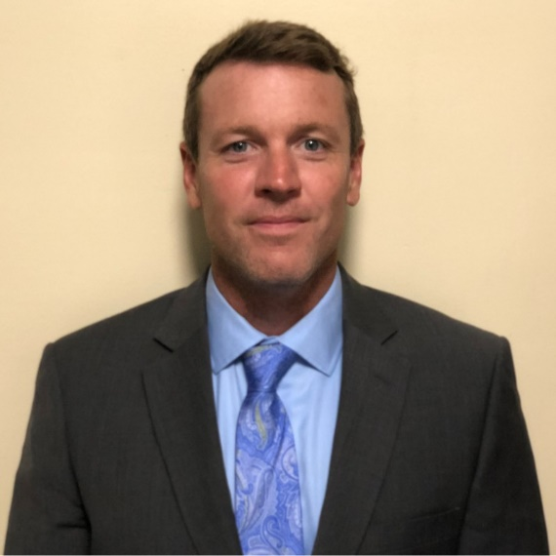
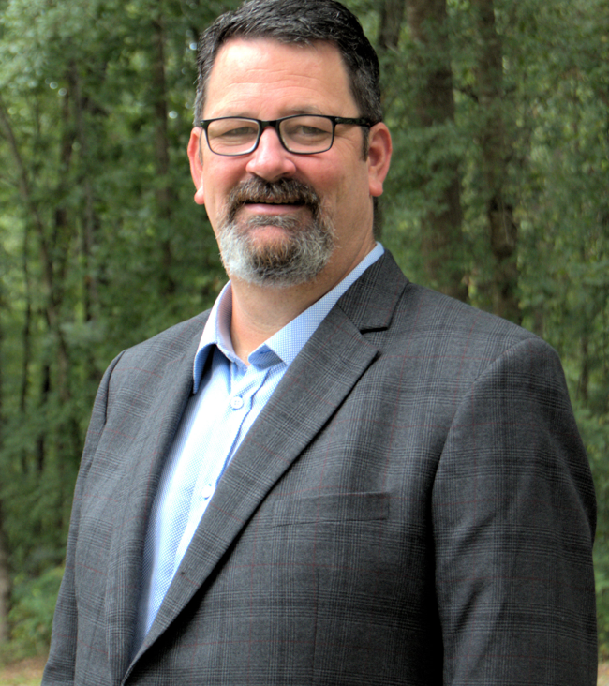
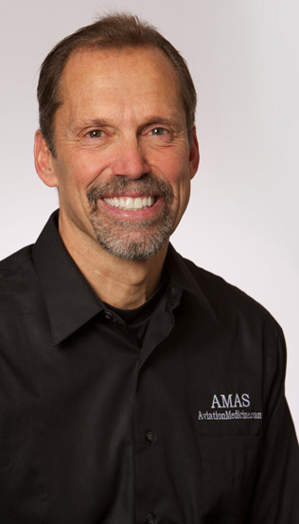
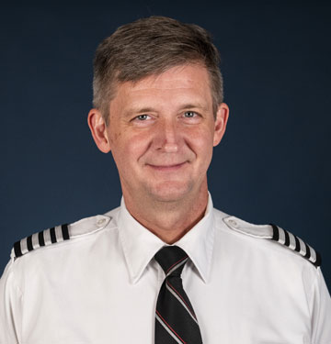
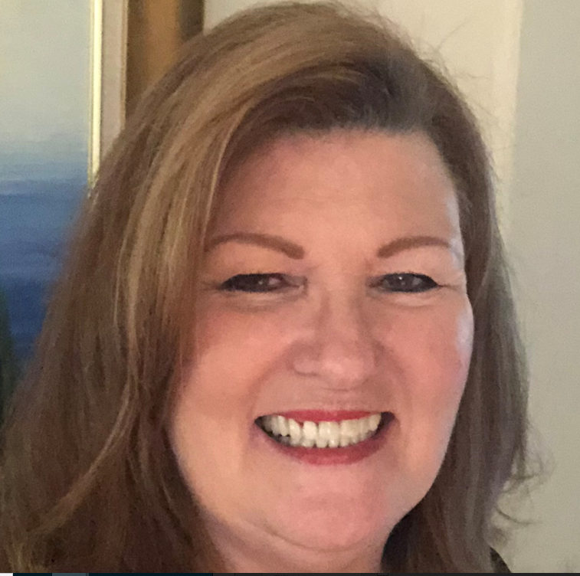
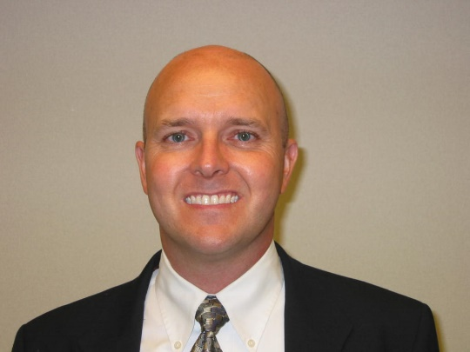
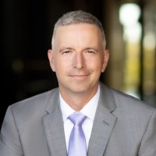
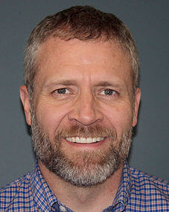
Act # 1 – Evaluation / Pre-HIMS Program
Starring – Captain Billy Petersen as Himself
Co – Starring
Captain Tom Stanley
Dr. Dave Rogers
Dr. Paul Sargent
Dr. Chad Burgdorff
Dr. Matt Dumstorf
Ms. Barb Woods
Dr. Navjyot Bedi

Slide 7
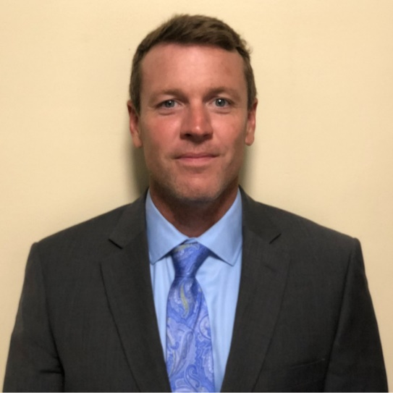
Scene 1 –Oh $#@! First DUI and HIMS Chair Advice
Deferral Criteria
Refusal to Test
BAC > 0.149
2nd Motor Vehicle Offense
Reporting Responsibilities
FAA Medical Application
FAR 61.15 Securities Div.
Self-Referral & Abstinence Option
Credit: Andrea Ferrario Unsplash
white police car photo – Free Milan Image on Unsplash

Slide 8
Scene 2 – Guidance from Your AME
Eval by HIMS PNP vs Local SAP (Non- DOT event)
Eval Info
FAA Medical File (405-954-4821 x4)
Police Report with BAC results
Court Records (if any)
Other Medical/ Legal / Driver’s Ed
Personal Statement
Contact HIMS Committee if in airline

Slide 9
Scene 3 – Am I a Drunk? HIMS Psychiatric Evaluation Eval
Assessment Only – NOT FAA Determination
FAR 67 Criteria vs. DSM 5
Collateral Info Critical
May contact Friends and Family
HIPAA Releases signed
Results sent to AME / IMS
If PNP determines FAR criteria met → option to enter Treatment before FAA review

Slide 10
Scene 4 – I’m Not A Drunk! Monitored Abstinence Considerations
Review @ AMCD May Require FAA HQ Psych Review
Dependence / Abuse / Misuse / No FAR Dx
Dependence / Abuse → Denial + Reconsideration Criteria
Monitored Abstinence SIA for Misuse
Does not meet FAR Dependence or Abuse Criteria
Misuse – Special Issuance - NOT HIMS PROGRAM
Abstinence for 1-3 years
HIMS AME / IMS
Testing Per FAA SIA

Slide 11
Scene 5 – Uh Oh! Positive EtG! Where Do I Go for Help?
AME / IMS notifies AMCD → MA SIA Withdrawn
Treatment Required, but How, Where, When, Why?
Who Pays?
Treatment Facility Search for Pilot
Barbara D. Woods, LCSW, SAP-Qualified

Slide 12
Where to Start
Facilities in my insurance network?
www.psychologytoday.com
www.naatp.org

Slide 13
Facilities w/ Experience Treating Pilots
Nine (minimum) with HIMS experience and education
Familiar with CFR Part 67
Co-occurring treatment available

Slide 14
Additional Resources
EAP
AME https://www.faa.gov/sites/faa.gov/files/hims-ames_4.pdf
HIMS Chairs https://himsprogram.com/hims-chairmen/

Slide 15
Where Do I Get Treatment/Aftercare/Insurance Info?
Barbara D. Woods, LCSW, ACSW
SAP Qualified
Barbara@barbarawoodsandassociates.com
972-467-7993

Slide 16
Scene 6 – What Is HIMS & How Does an Airline HIMS Program Work?
Treatment Options → Directed by Airline vs. Pilot Option
Visits by HIMS Committee during Treatment?
Meeting Requirements Pre- SIA
HIMS Handbooks, Disability Benefits, POC’s
Family Support & Education

Slide 17
Scene 7 - What is Treatment and Why Do I Need It??
Education Process
Consider Co-Morbidities
Individual and Group Sessions
AA / Birds of A Feather
? Cognitive Testing Baseline
Discharge Planning → Aftercare, Counseling
Relapse Prevention Retreats

Slide 18
Scene 8 – How Do I Get Back to Flying? Give Me a Checklist!
AME / IMS Relationship – Pilot Choice vs. HIMS Comm
ALL Rx Records Required
Aftercare, Individual and/or Family Counselling
AA Home Group, Sponsor (no reports required)
Abstinence Testing – Contact AME before Any Meds
No Accidental or Unknowing Ingestion
Frequency and Type @ AME / IMS Discretion
Timing of PNP Referral → All Records Sent by AME

Slide 19
Networking Break Landmark Foyer Next Session to begin at 11:00am
Meet A New Friend / Partner
LEARN
SHARE
APPLY

Slide 20
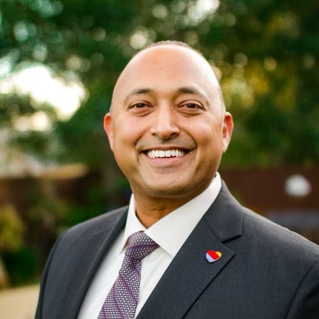
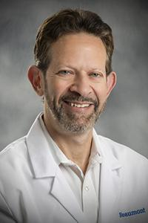
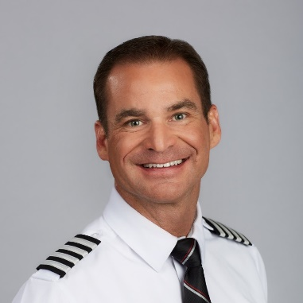
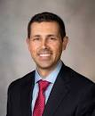
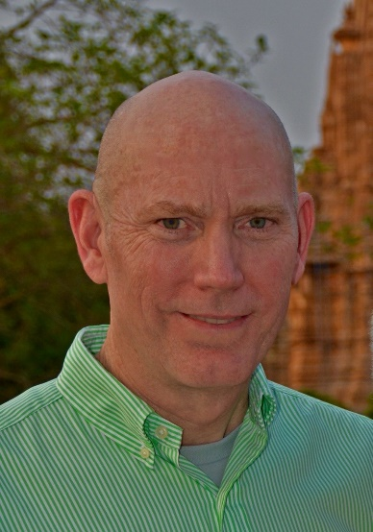
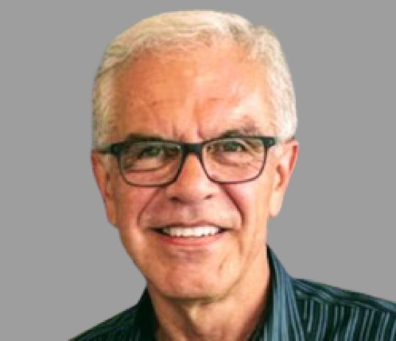
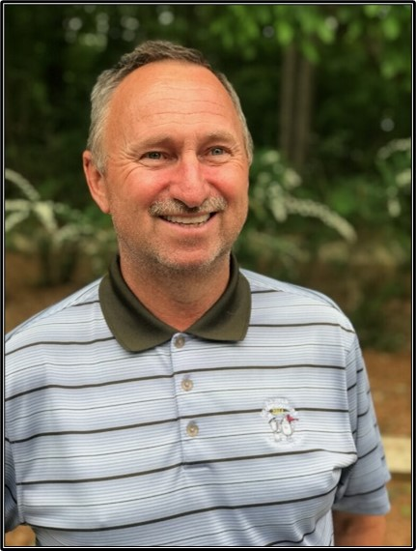
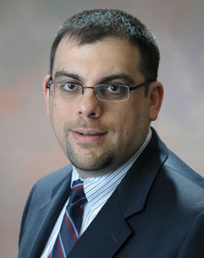
Act # 2 - Becoming a HIMS Participant
Starring – Billy Petersen
Co-Starring -
Dr. Dan DaSilva
Dr. Dan Danczyk
Dr. Bob Gordon
Dr. Chris Flynn
Dr. Chad Burgdorff
Dr. Randy Georgemiller
Dr. Matt Dumstorf
Capt. Troy DeJean
Capt. Jason Pettit
Capt. Dana Archibald
FO. Rick Mahoney

Slide 21
Scene # 9 – Is My Brain Pickled? The Neuropsychological Evaluation
What is Tested?
Aeromedically Relevant Neurocognitive Function
Review of Systems, Education, Family, Jobs, etc.
Personality Profile
Substance Use Indices
Results to HIMS Psychiatrist & AME
Impressions – not final determination
FAA Neuropsychologist Final Determination
Wallpaper by jam24 on Wallpapers.com

Slide 22
Scene #10 – I Have a Great Recovery, Don’t I? The Psychiatric Eval
Quality of Recovery Program & Risk of Relapse
Review ALL Records Treatment, Testing, Aftercare, NP, Legal, HIMS Comm
Dual Diagnosis ?
Diagnostic Impression & FAA Part 67 Criteria
Recommendations for Monitoring & Ongoing Treatment

Slide 23
Scene #11 – Doc, Get me Back in the Cockpit! The HIMS SIA Submission
AME / IMS Submission
All Records
HIMS Datasheet
Evidence of Knowing Pilot
Releases Signed
Submit via Huddle – 1st Class w/ HIMS Program,
Others to AMCD
Timeline, Frequency/Type of AME Contact
Continue All Recovery Activities While Waiting

Slide 24
Scene #12 – The Great and Wonderful Oz! What Happens Behind the FAA Curtain?
Review Psychiatry and Neuropsychology
Recommendation to FAS
Denials to Airman with Reconsideration Recommendations
Favorable Determination to AMCD for SIA Letter
Delays
Incomplete Records, Missing Datasheets
Not using FAR criteria
Physical Exam Not Current

Slide 25
Scene #13 – The Good News! What Goes Into an SIA?
Processing at AMCD – Drug & Alcohol AAM-330
SIA Modifications from Standard Stepdown
Closer monitoring recommendations
Who Gets Notified?
Pilot
AME / IMS
Company / HIMS Committee

Slide 26
Scene #14 – Showing Up for Accountability – The Monitoring Meeting
Attendance Expectations & Status
Group vs Individual Meetings
On-Duty vs. Off-Duty
Positive Space?
Feedback from HIMS Comm and Other Participants
Reports to AME / IMS

Slide 27
Scene #15 – My New BFF – The HIMS AME/IMS Role
AME Checklist / Affidavit
Meeting Requirements
Minimum Every 3 months – Initial Phase (F2F 6 months)
Non-Compliance Actions
Pilot Responsibility!!!
Warning to Pilot
Notification of AMCD
Withdrawal of SIA

Slide 28
Scene #16 – I’m Broke – The Gift of the Aviation Family Fund
Financial hardships pilot face
How to apply – what is covered
How to donate, contribute, services in kind – tax deductible 501.c.3
https://www.aviationfamilyfund.org/

Slide 29
Aviation Family Fund
AFF assists in providing supplemental funding during the recovery process for alcohol and drug-related dependence, and mental health issues. We are available to anyone in the aviation industry.
Dana C. Archibald

Slide 30
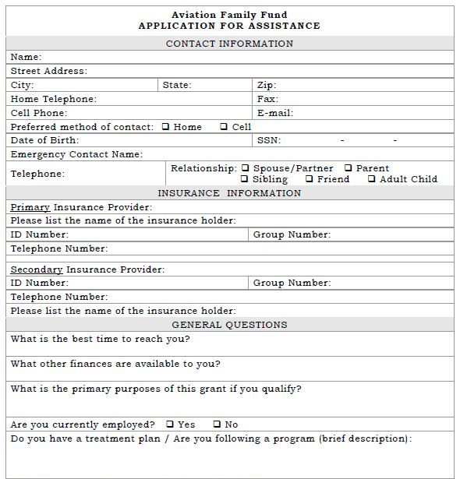
How Does Someone Apply?
What Do We Pay For?
Inpatient
Outpatient
Aftercare
COBRA
Rent
Electric
Mortgage
Water bill
Doctor bills, (AME, P&P Certificates, etc.)
Soberlink
Apply via website: www.aviationfamilyfund.org

Slide 31
How Does One Donate?
In-Kind Donations
Providers may offer discounted fees off of standard charges for evaluations and services; tax deductible receipts are sent for all donations and in-kind donations
Providers may limit the number of discounted cases, or receive referrals, or continue to receive referrals (for existing providers).
For documentation purposes, we can provide our tax ID number. This can be for P&P, HIMS, after care, AME, etc.
Monthly, through your bank’s bill pay
Text: AFFHOPE to 44321
Personal or business check mailed to the address on website
Apply via website: www.aviationfamilyfund.org

Slide 32
Audience Q&A

Slide 33
Lunch City View 12:30-1:30
Meet A New Friend / Partner
LEARN
SHARE
APPLY

Slide 34
Act # 3 - Later Progress in HIMS Program & Step Down
Starring – Billy Petersen
Co-Starring –
FO. Rick Mahoney
Capt. Dave Retnam
Capt Jason Pettit
Dr. Bob Gordon
Dr. Matt Dumstorf

Slide 35
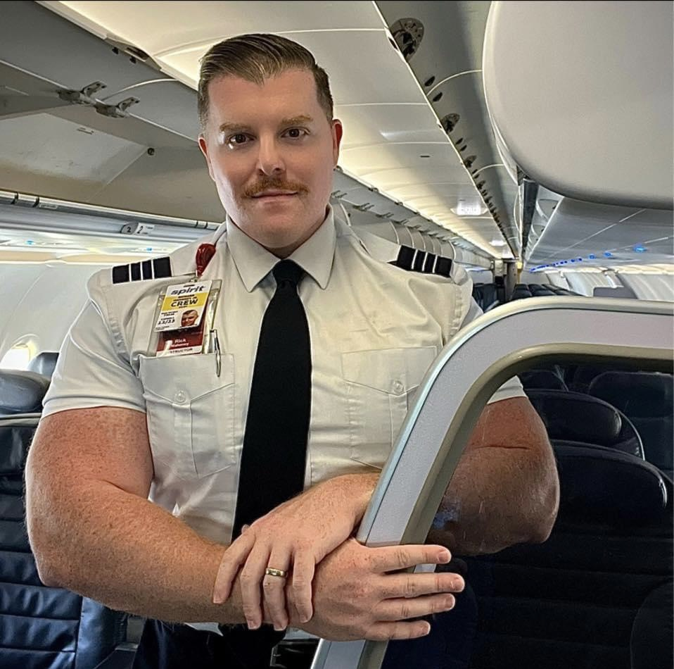
Scene #17 - My Relationship with My Peer Monitor

Slide 36
Scene #18 – What Does My Boss Think of Me? Company Monitor

Slide 37
Scene # 19 – Practicing Serenity – My AME/IMS Controls My Fate

Slide 38
Scene #20 – Stepping Up to Step Down… The Decision

Slide 39
Scene #21 – Chocks Never In - A Pilot’s Reflection on the HIMS Journey

Slide 40
Networking Break Landmark Foyer Next Session to begin at 3:00pm
Meet A New Friend / Partner
LEARN
SHARE
APPLY

Slide 41
Professional Breakouts
Pilots – Landmark Ballroom
Airline Management - Mockingbird
AME / IMS – Highland 4-6
Psychiatrists – Highland 1-3
Neuropsychologists - Maple
Appoint Spokesperson for Tomorrow AM

Slide 42
Wednesday / Thursday Logistics
SWA Facilities Tour 5:30pm
-Shuttle to pickup in front of hotel
Advisory Board Meeting 5:30pm- Held in Knox
Open Birds Meeting 7:00am – Held in Mockingbird
Transportation to DFW / DAL
-There will be 3 buses to transport to the airports. They will be outside beginning at 12:15pm
CME Test
- Deann King, FAA Aeromedical Education Division, CME coordinator
FAA AME / PNP updates

Slide 43
Best Practices
Pilots
Airline Management
AMEs
Treatment center/ Outpatient Aftercare / Counseling
Neuropsychologists
Psychiatrists
FAA

Slide 44
Networking Break Landmark Foyer Next Session to begin at 11:00am
Meet A New Friend / Partner
LEARN
SHARE
APPLY

Slide 45
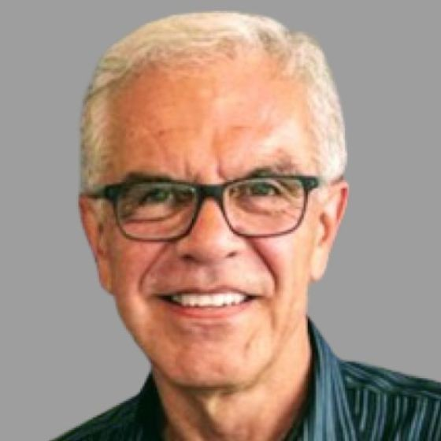
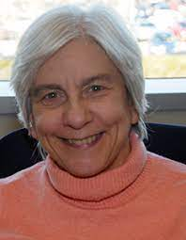
Audience Q&A
Identify Yourself and Your Profession
Limit Question to 30 seconds
Speak into Mic for Virtual Attendees
Direct Question to One of Our Actors
HIMS Basic Education Seminar 2023
Westin Hotel Denver International Airport
September 9 – 11, 2023 Registration Opens in July

Slide 46
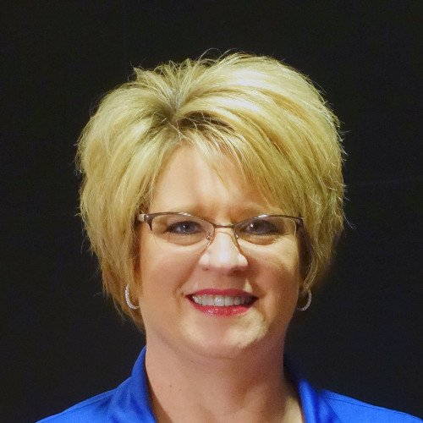
CME Test
Deann King, Ph.D.
FAA Aeromedical Education Division, AAM-400 CME Coordinator

Slide 47
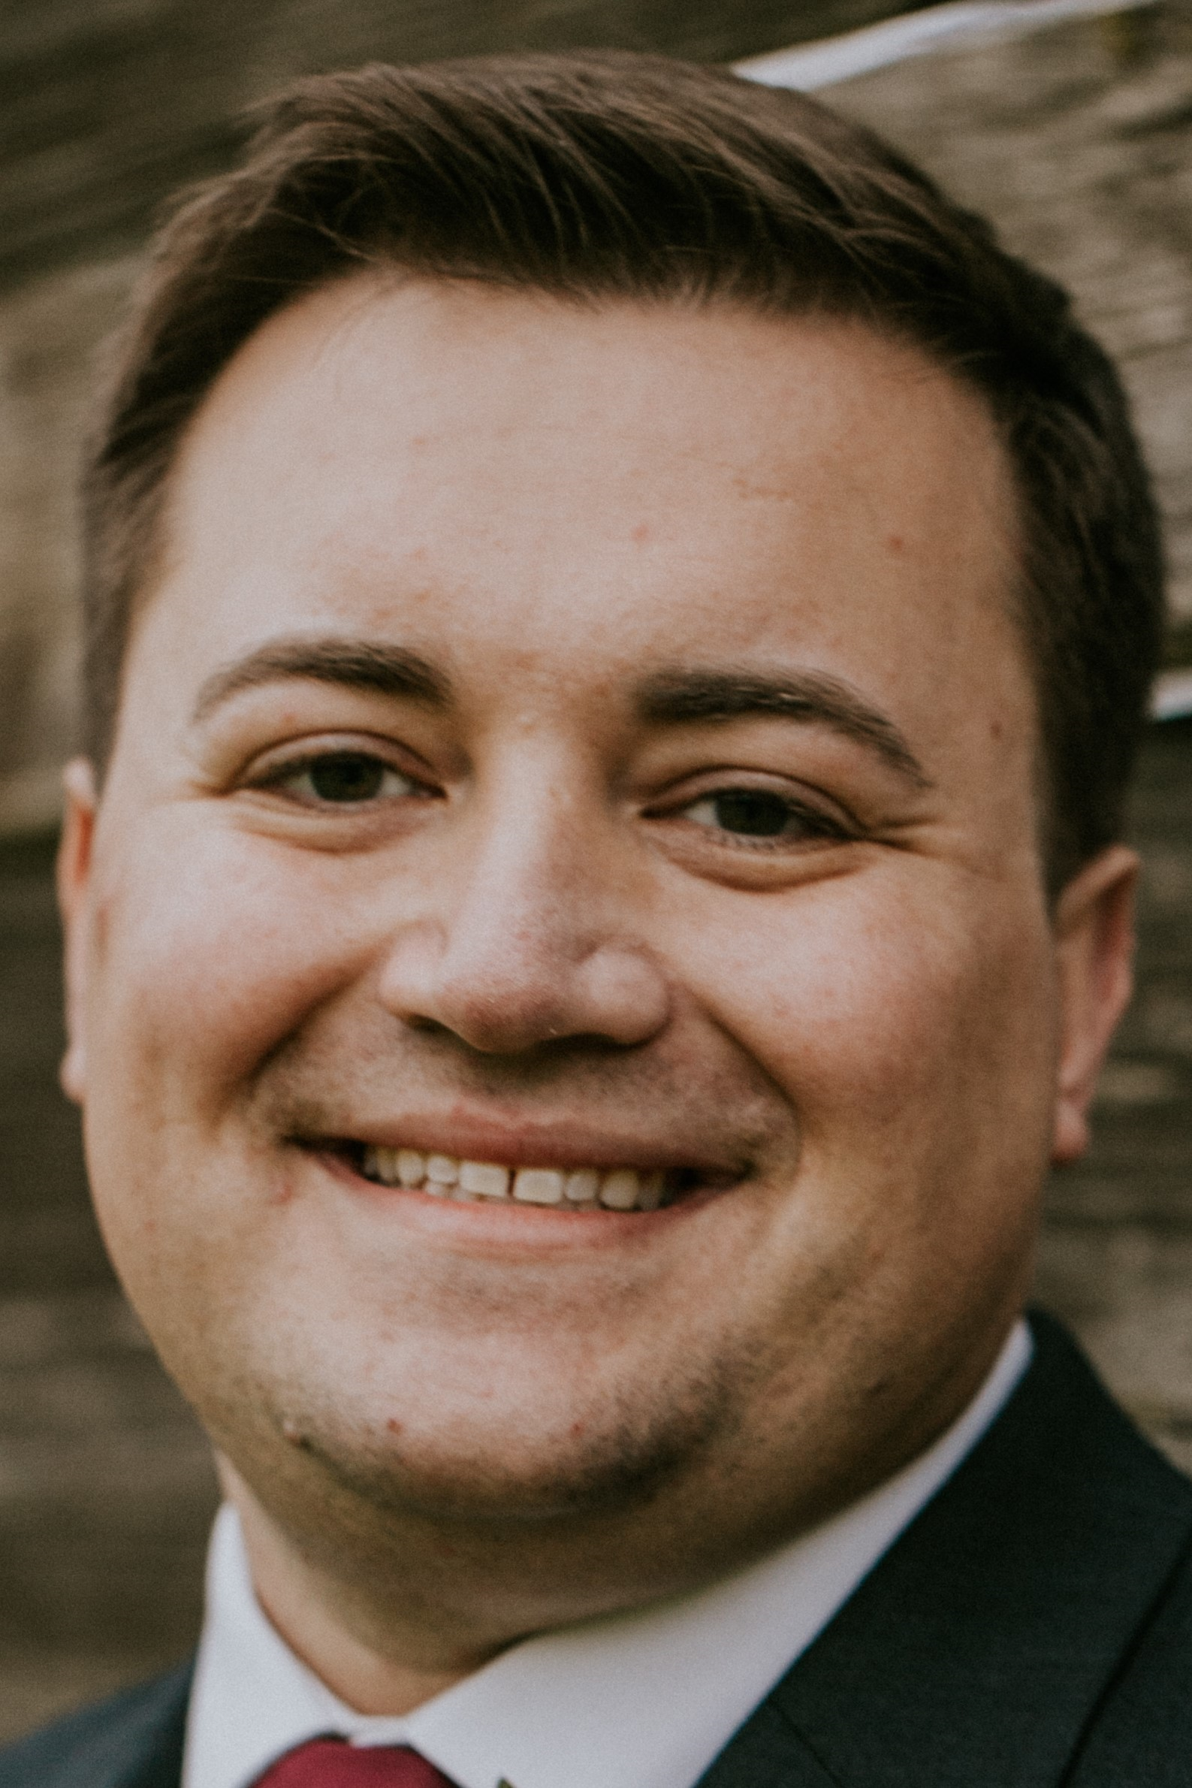
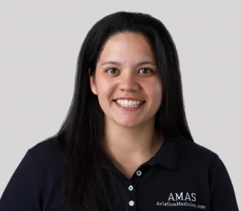
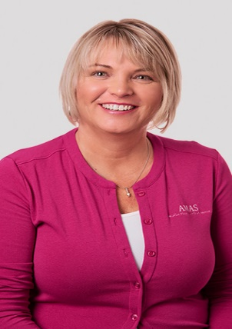
Conclusion
Actors (True Professionals)
FAA
International Attendees
Cvent and Hotel Staffs
HIMS Team
Critiques
CME

Slide 48
Special thank you to Southwest Airlines and Southwest Airlines Pilots Association for sponsoring the 2023 HIMS AT Seminar

Slide 49
THANK YOU
FOR PARTICIPATING IN THE 2023 HIMS ADVANCED TOPICS SEMINAR
Please remember to fill take our Post Seminar Survey to let us know how we did!

