Slide 1
HIMS Basic Education Seminar 2023 - WELCOME
Quay Snyder, MD, MSPH – FAA/ALPA HIMS Program Manager
FO Craig Ohmsieder – Spirit Airlines – ALPA National HIMS Chairman
CPT Billy Petersen – Jet Blue Airlines – ALPA National HIMS Vice-Chairman

Slide 2
HIMS Goals
Provide a structure within which pilots afflicted by the disease of substance abuse/dependence can be identified, treated, and returned to duty - saving lives and careers

Slide 3
Attendees
Pilot Volunteers - 171 6
Airline Mgmt - 33 2
AME’s - 43 4 First Timers (non-pilot)
P&P - 60 1 AME – 34,
FAA Staff - 10 3 NP – 36, P - 8
General - 19 3 TOTAL
Speakers/AB - 32 3 ATTENDEES
HIMS Staff - 5 1 395 (42)
International - 14 5

Slide 4
International Guests
-- Australia
Canada
Hong Kong
Japan
New Zealand
Pakistan
Puerto Rico (US)
South Africa
United Kingdom
US and NZ military

Slide 5
Special Guests
Dr. Susan Northrup – FAA Federal Air Surgeon - virtual
FAA –
Gary Sprouse & Linda Johnson – AME Test questions
Sue Glowacki – AME and PNP HIMS Designation questions
FAA DUI Reporting Team
Birds of a Feather – Tammy H./ Bill T./ Beth / Scott M.

Slide 6
Challenges - Diversity of Audience
Different
Professions – Skill sets
Vocabularies
HIMS experience levels
FAA certification processes
National Civil Aviation Authorities / Cultures
Employer CBA’s, MOU’s, LOA’s
GA vs airline resources
Common Goal – Aviation Safety, Save Lives

Slide 7
Information Resources
Agenda Booklet
HIMS Manual - Cvent App
Anthony Swigon, Zachary Pope
Westin and DIA links
FAA Staff – AME’s, P&P’s, CME
Drs. Randy Georgemiller/ Joyce Fowler - Neuropsychologists
AMAS Staff
www.HIMSprogram.com
Image: https://www.freeiconspng.com/img/41637

Slide 8
Critiques
Take Very Seriously → Improvements
Same Venue
Virtual Attendance Option
More FAA Q& A / Breakouts
Presentations on www.HIMSprogram.com & HIMS App
Electronic Manuals – Pre & Post Seminar
Longer Breaks – More Networking / Q&A
Complete Critiques on App after every talk PLEASE!
Image: Free-Photos from Pixabay

Slide 9
Continuing Education
AMA PRA & AAFP Cat 1 CME – 14.75 hours
Psychologist CE hours – ≤ 10.0 hr in-person only
All speakers have signed financial disclosures None had prohibited relationships to report
FAA credit for HIMS AME Periodic Training (required every 3 years) – Sue Glowacki Passing test grade required >70% Turn into FAA staff Using App
Must attend ENTIRE seminar
Image by Mohamed Hassan from Pixabay

Slide 10
FAA HIMS AME & PNP Listings
New to HIMS?
In-Person Attendees:
Visit the FAA information table near registration area.
Virtual Attendees:
Email 9-AAM-HIMS@faa.gov for details.
Current HIMS Provider?
If there is an update to your contact information,
take the same steps as above.

Slide 11
Meals and Transportation
Dinner Options
Hotel Restaurant –Airport Outside Security – 6 Locations
Airport Inside Security – 90 Locations www.flydenver.com/dine
Know Crew Member
Driver’s License in AM
Light Rail - $10.50 ($5.25/Free) daily pass to Denver LoDo
Uber and Taxis
Hotel shuttles to Tower Blvd
URL in app

Slide 12
Fellowship
Birds of a Feather / AA meetings
Open Sunday 0700– Douglas Fir
Closed Saturday/Monday 0700 - Douglas Fir
Breakouts and Joint sessions
Rooms available
Message Board
Conversations outside away from doors
Cell phones on silent.
In place. On time

Slide 13
Safety & Assistance
Exits and Meeting areas
Smoking areas
AMAS staff – Red
Faith Leach
Marisa Olson
Stephanie Orr
(Caitlin Bruton)
Encore App Staff – Anthony Swigon & (Peyton Reed)

Slide 14
House Rules
LEARN
Question the Experts & Faculty
SHARE
Engage Newcomers and Old-Timers
APPLY
Bring the Best to Your Airline or Practice
Fill out CRITIQUES DAILY!

Slide 15
SPONSORS – THANK YOU !!!!

Slide 16
HIMS Overview, Database, Web Site Tour
FO Craig Ohmsieder – Spirit Airlines – ALPA National HIMS Chairman
Quay Snyder, MD, MSPH FAA / ALPA HIMS Program Manager
CPT Billy Petersen – Jet Blue Airlines – ALPA National HIMS Vice-Chairman

Slide 17
Three Main Questions
Why ?
What ?
How ?
Notes:
Why do we need HIMS
What Exactly is HIMS
How does HIMS work

Slide 18
Why do we need HIMS?
Image by Mohamed Hassan from Pixabay
Notes:
Let's go back to the 1960’s and 1970’s

Slide 19
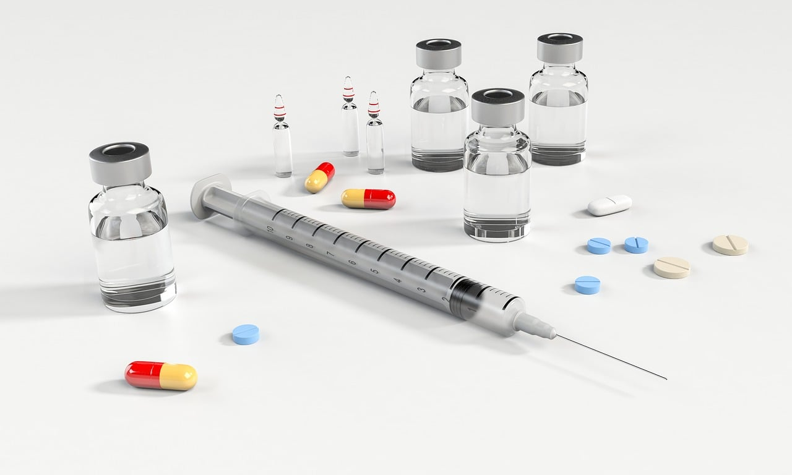
Why do we need HIMS?
10% of United States population is Chemically Dependent
Image by Ray Shrewsberry • from Pixabay
Image by OpenClipart-Vectors from Pixabay
Image by Clker-Free-Vector-Images from Pixabay
Image by Ray Shrewsberry • from Pixabay
Image by digital designer from Pixabay
Notes:
This is true now
Was true 50 years ago

Slide 20
Why do we need HIMS?
10% of United States population is Chemically Dependent
Are Pilots different? – Data suggested they were
Notes:
Pilots were not going to Treatment Centers
Pilots were not attending Alcohol Help Groups
Pilots were not getting in trouble at work for Drinking

Slide 21
Why do we need HIMS?
Early 1970’s – Human Intervention and Motivation Study
Notes:
Led by ALPA and a group of Doctors
Researched the need for alcohol treatment for pilots

Slide 22
Why do we need HIMS?
Early 1970’s – Human Intervention and Motivation Study
Pilots are the SAME – Just better at hiding it
Notes:
Why are they Better
Why does it appear that Pilots do not suffer from addiction at the same rate as non-pilots?

Slide 23
Why do we need HIMS?
Early 1970’s – Human Intervention and Motivation Study
Pilots are the SAME – Just better at hiding it
Desire to appear professional
Notes:
Pilots have so much invested in their career
So much time
So much Money
They know addiction can take that away
So they build up this Barrier of Professionalism to protect them

Slide 24
Why do we need HIMS?
Early 1970’s – Human Intervention and Motivation Study
Pilots are the SAME – Just better at hiding it
Loyalty among flight crews
Notes:
This stems from the early days of military pilots
A Band of Brothers
I will do anything to protect my fellow Pilots
If you have a problem with drinking too much…I will protect you

Slide 25
Why do we need HIMS?
Early 1970’s – Human Intervention and Motivation Study
Pilots are the SAME – Just better at hiding it
Pilot personality contributes to this - Can go without drinking to get the job done
Notes:
This goes back to Professionalism
The Mission – Completing the Flight – Is the most important thing
I can put my Alcoholic Cravings on Hold to complete the mission
This makes Identification difficult – I haven’t had a drink in 4 Days….How can I have a Problem?

Slide 26
Why do we need HIMS?
Early 1970’s – Human Intervention and Motivation Study
Pilots are the SAME – Just better at hiding it
Pilot schedules promote binge drinking
Notes:
2 Different Scenarios Here:
1- Pilot is perfect Husband & Father at Home – Schedules flying to have Great “Drinking” overnights in great Cities with Great Bars – Almost Always goes alone w/o other Crew – nearly impossible to detect
2- Pilot drinks non-stop at home – Schedules flying for minimal work and never touches a drop of alcohol on his trip – Back home a few days later and drinks non-stop
This becomes a problem for the pilot when the two Overlap – One is not enough, and they must now drink at home and on trips – Now it is much harder to hide

Slide 27
Why do we need HIMS?
Early 1970’s – Human Intervention and Motivation Study
In 1974 the HIMS Program was established
Notes:
With all that said, and all that research done: HIMS was established

Slide 28
What is HIMS?
Image by Mohamed Hassan from Pixabay
Notes:
So what exactly is HIMS?

Slide 29
What is HIMS?
HIMS is a Pilot Specific Model
A Safe and Effective way for Pilots with Substance Use Problems to get Help while Protecting their Flying Careers
Notes:
This is HIMS – But HIMS is also a few other things-

Slide 30
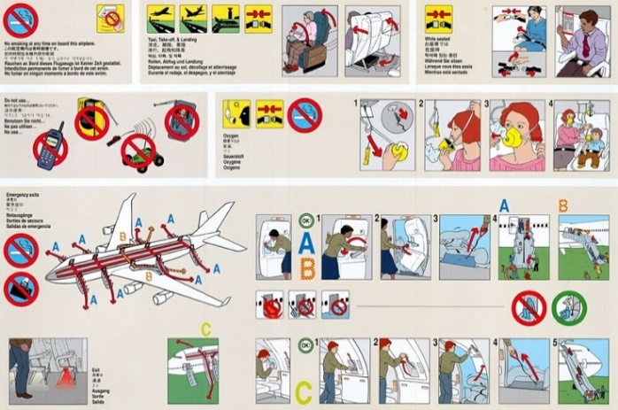
What is HIMS?
HIMS is a SAFETY Program
Protect the Public / Flying Profession
Save the Life
Save the Family
Save the Career
Notes:
Again…in 20+ years of HIMS – I have only seen a handful of cases where the pilot could not return to flying
Most of those were the pilot choosing drinking over flying or having a co-existing condition that prevented it
What else is HIMS?

Slide 31
What is HIMS?
HIMS is a MONITORING and SUPPORT Program
The FAA and the Airline use HIMS to evaluate the Pilot’s Recovery and Return to Flying
There is a built-in Support System to assist the Pilot through the entire HIMS Process
Notes:
So, the pilot is provided with all the tools needed to build a life in recovery away from alcohol and drugs
The pilot is given a support program to help him through all this
The FAA and the Airline also use that support program to monitor the pilot’s progress and evaluate when he is ready to return to flying
All of this is referred to as the HIMS Process

Slide 32
What is HIMS?
HIMS is a Process
How does HIMS work?
Notes:
What exactly is this Process?

Slide 33
How does HIMS work?
Image by Mohamed Hassan from Pixabay
Notes:
The steps are:

Slide 34
How does HIMS work?
The HIMS PROCESS
Notes:
The steps are:

Slide 35
How does HIMS work?
The HIMS PROCESS
Identification / Evaluation
Image by Jan from Pixabay
Notes:
First is Identification and Evaluation

Slide 36
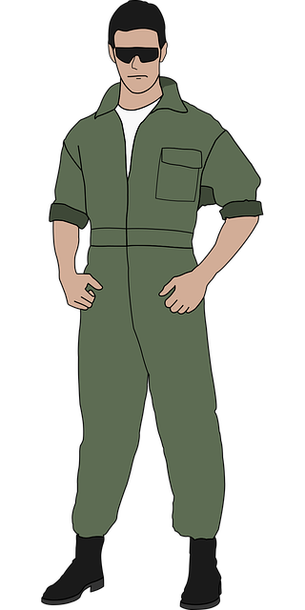
Identification / Evaluation
Who has the alcohol problem?
Image by OpenClipart-Vectors from Pixabay
Image by Mohamed Hassan from Pixabay
Freeimages.com/photo/portrait-of-airline-pilot-2068794
Image by methodshop from Pixabay
Notes:
This can be Difficult
As said earlier, Pilots are very good at hiding their drinking problems
It is very hard to just look at a pilot and say “He has the Problem”
And Most Pilots will not just come forward and Say “I’m drinking too much, and I need Help”
Why is this?

Slide 37
Identification / Evaluation
1. Does your drinking / using cause problems?
-Legal
-Relationship
-Employment
Image by fsHH from Pixabay
Notes:
So we have to ask questions -

Slide 38
Identification / Evaluation
1. Does your drinking / using cause problems?
-Legal
-Relationship
-Employment
2. Can you predict how many drinks you will have and what
will happen once you start drinking / using?
Image by fsHH from Pixabay
Notes:
Most alcoholics and addicts will set limits for how much they will consume – and almost always break that limit

Slide 39
Identification / Evaluation
1. Does your drinking / using cause problems?
-Legal
-Relationship
-Employment
2. Can you predict how many drinks you will have and what
will happen once you start drinking / using?
3. Do you have to hide your drinking?
Amounts, bottles, geograpically
(Pre-drinking / Only had 2!)
Image by fsHH from Pixabay
Notes:
Hide Bottles at Home
Make really strong Mixed drinks –
Do you do things that make it appear you are drinking less?
Drink several on your own before you meet with rest of crew – appears you are drinking less

Slide 40
Identification / Evaluation
Health Issues
Pilots Struggle with
Denial
Fear
Lack of Trust
Ego
Not Ready to Stop
Failed Alcohol Test
Sick Leave
Layover Incident
Peer Concerns
Training Issues
Family Problems
DUI
Image by Peggy und Marco Lachmann-Anke from Pixabay
Image by Peggy und Marco Lachmann-Anke from Pixabay
Image by Peggy und Marco Lachmann-Anke from Pixabay
Notes:
Pilots struggle with……
While they are surrounded by all these issues

Slide 41
Identification / Evaluation
ALL Addicts need Consequences to break delusion
Layover Incidents
Peer Concerns
DUI / Illegal Possession
Failed Alcohol / Drug Test
Sick Leave
Training Issues
Family Problems
Image by Gerd Altmann from Pixabay
Notes:
If we can lay out these issues in front of them, these consequences… one by one…
They can start to recognize they may have a problem

Slide 42
Identification / Evaluation
My Goals
Get the pilot to see - there may be a “Problem”
Get the pilot to agree to a Professional HIMS Evaluation
Notes:
Again:

Slide 43
How does HIMS work?
The HIMS PROCESS
Identification / Evaluation
Treatment
Image by Rosy / Bad Homburg / Germany from Pixabay
Notes:
If the Pilot is Diagnosed then we move on to Treatment

Slide 44
Treatment
A Comprehensive Program for the Pilot
In-Patient Residential
With other Pilots / Professionals
28 Days +
Staff is trained to work with HIMS / Pilots
Prepares Pilot for life in Recovery

Slide 45
How does HIMS work?
The HIMS PROCESS
Identification / Evaluation
Treatment
Recovery Program (AA/NA)
Notes:
While the pilot is in Treatment – we introduce and get him started on a Recovery Program
Once the pilot gets out of treatment – everything they do centers around their Recovery Program

Slide 46
Recovery Program
A New Way of Life for the Pilot
Alcoholics Anonymous (AA) is best known but there are others
Requires Rigorous Honesty
Requires change in all aspects of Pilot’s life
Requires the Pilot to open up to Others
Progress not Perfection

Slide 47
How does HIMS work?
The HIMS PROCESS
Identification / Evaluation
Treatment
Recovery Program (AA/NA)
Aftercare
Image by rudamese from Pixabay
Notes:
Something else that starts immediately after Treatment is Aftercare
Anyone can stay Sober locked in a Treatment Center
Aftercare helps bridge the gap between treatment and this new way of life

Slide 48
Aftercare
The Transition from Treatment to Sober Life
Group Setting
HIMS Trained Group Leader
With other Pilots / Professionals
Weekly Meetings
Reports sent to HIMS AME / IMS
Notes:
Details of meetings are not sent in reports, but the Pilot’s participation and overall progress in recovery are included

Slide 49
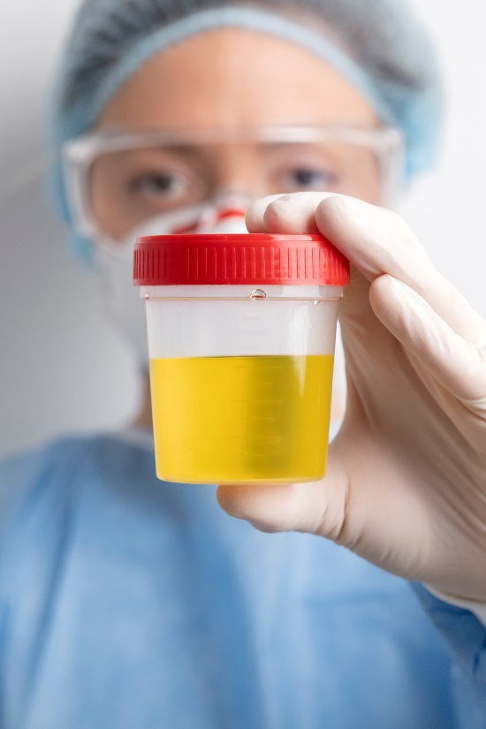
How does HIMS work?
The HIMS PROCESS
Identification / Evaluation
Treatment
Recovery Program (AA/NA)
Aftercare
No Notice Alcohol / Drug Testing
Image by <a href="https://www.freepik.com/free-photo/lab-doctor-performing-medical-exam-urine_25182642.htm#query=urine%20test&position=1&from_view=keyword&track=ais&uuid=0d5946c7-9895-4278-a595-2b5763bdc46f">Freepik</a>
Notes:
Another Key part of the HIMS Process -

Slide 50
No Notice Alcohol/Drug Testing
Trust but Verify
Separate from Random DOT Testing
Minimum of 14 tests per 12 months
Windows test for Both On and Off Duty Use
Should adjust per individual Pilot –
ETG Test
Hair/Nails
Is very accurate – But still One data point
Notes:
Always look at the Big Picture

Slide 51
How does HIMS work?
The HIMS PROCESS
Identification / Evaluation
Treatment
Recovery Program (AA/NA)
Aftercare
No Notice Alcohol / Drug Testing
Psychological & Psychiatric Evaluations
Image by Peggy und Marco Lachmann-Anke from Pixabay

Slide 52
Psychological & Psychiatric Evaluation
Does their Mental Condition allow for a Safe Pilot?
Evaluations are by HIMS Trained Doctors
Pilot should be well established in Recovery
Should not begin evaluations if any residual effects of long-term alcohol use are present
Notes:
Evaluators are looking for a completely changed lifestyle – this takes time

Slide 53
How does HIMS work?
The HIMS PROCESS
Identification / Evaluation
Treatment
Recovery Program (AA/NA)
Aftercare
No Notice Alcohol / Drug Testing
Psychological & Psychiatric Evaluations
Peer Pilot Monitoring
Image by Eddie Mar Delos Angeles from Pixabay
Notes:
This is another pilot who can come alongside this new pilot in recovery and help them along the way
-Teammate
-Guide
-Mentor
-Also an Evaluator

Slide 54
Peer Pilot Monitoring
A Trusted Volunteer
Must be HIMS Trained
Ideally has been through HIMS as well
Is a Resource and an Advocate
Must also Hold Pilot Accountable
Reports sent to HIMS AME / IMS

Slide 55
How does HIMS work?
The HIMS PROCESS
Identification / Evaluation
Treatment
Recovery Program (AA/NA)
Aftercare
No Notice Alcohol / Drug Testing
Psychological & Psychiatric Evaluations
Peer Pilot Monitoring
Company Pilot Monitoring
Image by <a href="https://www.freepik.com/free-photo/low-angle-tall-building-with-many-windows_5253567.htm#query=office%20building&position=38&from_view=search&track=ais&uuid=ed8459de-235b-413d-8767-fed024de1f1e">Freepik</a>
Notes:
Very Similar to Peer Pilot Monitor
From more of a position of authority

Slide 56
Company Pilot Monitoring
A member of Airline Management
Must be HIMS Trained
Helps pilot adjust in Return to Flying
Is a Resource and an Advocate
Must also Hold Pilot Accountable
Reports sent to HIMS AME / IMS

Slide 57
How does HIMS work?
The HIMS PROCESS
Identification / Evaluation
Treatment
Recovery Program (AA/NA)
Aftercare
No Notice Alcohol / Drug Testing
Psychological & Psychiatric Evaluations
Peer Pilot Monitoring
Company Pilot Monitoring
The HIMS AME / IMS
Image by <a href="https://www.freepik.com/free-photo/doctor-discussing-with-patient_5480876.htm#query=doctor%20consultation&position=22&from_view=search&track=ais&uuid=9d79a4c7-fad8-4103-968b-330946799b3f">Freepik</a>
Notes:
The final piece of the puzzle that brings everything together is the Pilot’s HIMS Doctor

Slide 58
HIMS AME / IMS
The Manager of the Team
He Guides the HIMS Process
He collects all Reports on the HIMS Pilot
He Evaluates the Pilot’s Progress
Should establish a Relationship with the Pilot
Makes Final Decision on when to request Return to Flight status with the FAA
Image by Megan Rexazin Conde from Pixabay
Notes:
The FAA can not do an in-depth evaluation on every pilot –
They trust the HIMS Trained Aviation Doctor to do this evaluation for them
This Doctor then sends a complete packet to the FAA explaining and Documenting why the Pilot should be Returned to Flying

Slide 59
How does HIMS work?
The HIMS PROCESS
Identification / Evaluation
Treatment
Recovery Program (AA/NA)
Aftercare
No Notice Alcohol / Drug Testing
Psychological & Psychiatric Evaluations
Peer Pilot Monitoring
Company Pilot Monitoring
The HIMS AME / IMS
Notes:
These 7 steps of the HIMS Process are also included in the pilot’s monitoring program

Slide 60
Step-Down Monitoring Process
Describes Monitoring after Pilot returns to Flying
Lifetime Abstinence is Required
Trust but Verify
Start with very strict requirements
Requirements are relaxed as Time and a Strong Foundation in Recovery are built
Notes:
Which leads us to the Step-Down Monitoring Process

Slide 61
Step-Down Monitoring Process
Notes:
Which leads us to the Step-Down Monitoring Process

Slide 62
Does HIMS Work?
Image by Mohamed Hassan from Pixabay
Notes:
I first came into HIMS in 1997
Through Multiple DUI’s – Extensive Drug and Alcohol Use – Calling in Sick over and over and over
Relapse – I came into HIMS then went back out drinking – Then back into HIMS
I was: Bad Husband – Bad Father – Bad Employee
Because there was a HIMS Program – Because of people there to help me in spite of all the bad I had done-
Through HIMS – I completely Turned my life around
Good Husband – Good Father – Good Employee
Pilot Peer Monitor
HIMS Chairman for my Airline - National HIMS Chairman
I could tell story after story of Pilot’s lives and careers that have been saved through HIMS
It really does work

Slide 63
HIMS
Database
Image by Gerd Altmann from Pixabay

Slide 64
Drug & Alcohol Overdose Deaths April 2020 - 21
Total – 100,306 275 / Day
Opioids – 75, 773
Stimulants ~ 20%
Alcohol Overuse Deaths
140,000 deaths in US ~ 5 M worldwide (5.3% of all deaths)
380 deaths/day
1/10 deaths age 20-64 10,142 additional MVA deaths in 2019
22% Opioid/benzo OD’s
3rd leading cause US Preventable Deaths
www.cdc.gov/nchs/nvss/drug-overdose-deaths.htm#find-our-data
www.niaaa.nih.gov/alcohols-effects-health/alcohol-topics/alcohol-facts-and-statistics/alcohol-related-emergencies-and-deaths-united-states

Slide 65
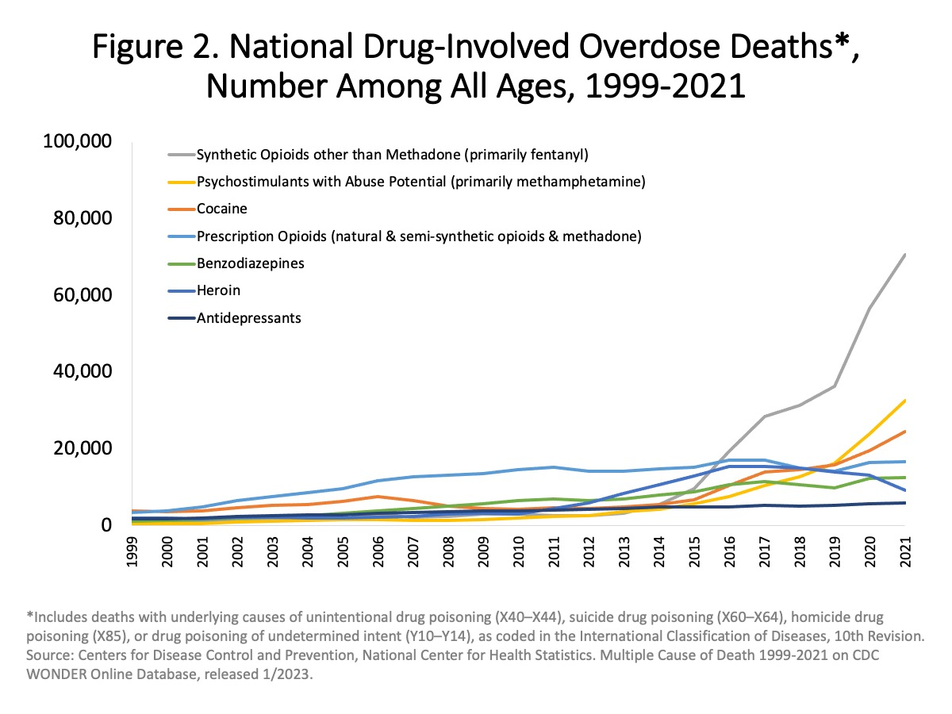
Source: https://nida.nih.gov/research-topics/trends-statistics/overdose-death-rates

Slide 66
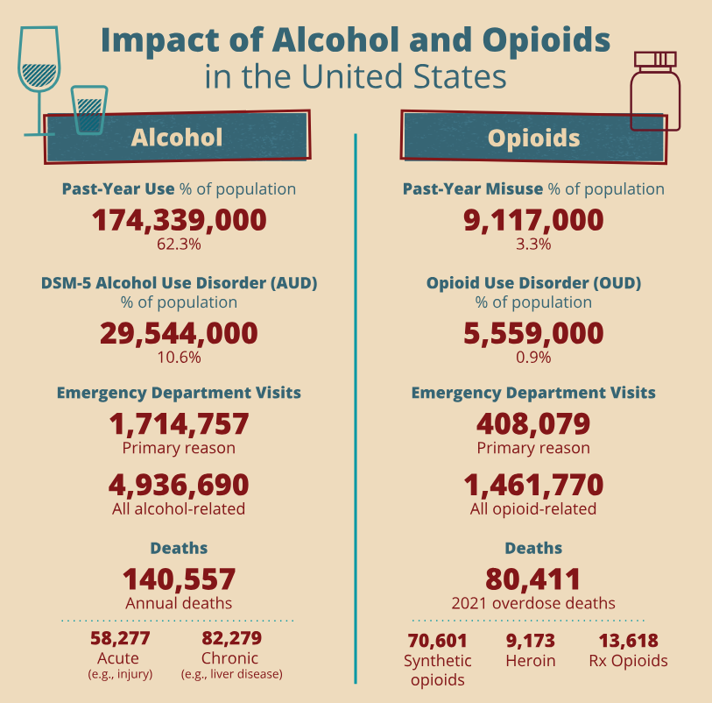
Source: https://www.niaaa.nih.gov/alcohols-effects-health/alcohol-topics/alcohol-facts-and-statistics/alcohol-related-emergencies-and-deaths-united-states

Slide 67
Percentage Substance Usage US ≥ 26 y.o.
Substance Lifetime 2020 Last Month SUD
Alcohol 85.6 69.5 54.9 10.3
Illicit Drugs 52.9 22.2 12.6 5.6
Marijuana 48.9 16.3 10.8 5.2
Cocaine 16.5 1.7 0.6 0.5
Opioids/ates n.r. 3.9 1.3 1.3
Hallucinogens 17.5 2.0 0.5 0.1
Methamph. 6.8 1.1 0.8 0.6
Rx Psycho n.r. 5.6 2.0 1.3
Source: National Survey on Drug Use & Health 2020 and NIAAA Alcohol Facts

Slide 68
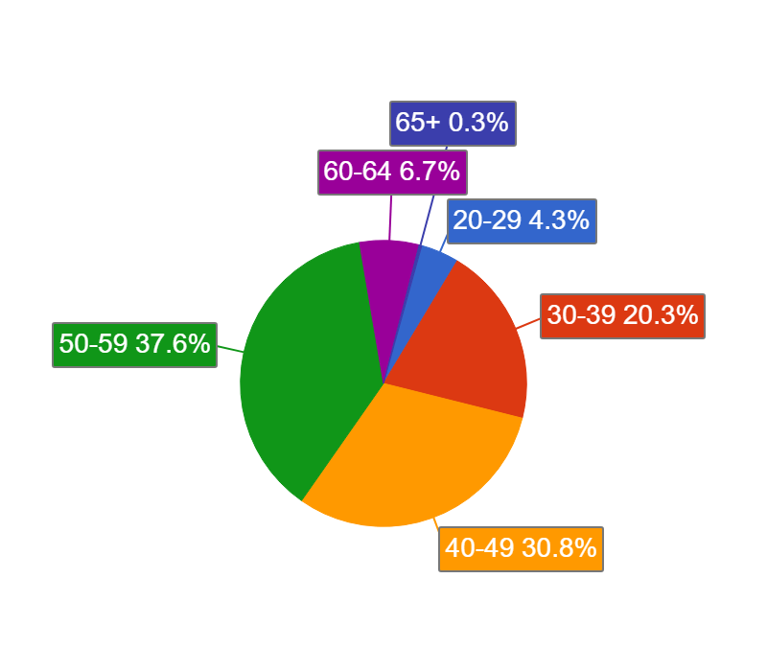
Age Distribution
Age | Pilots | %
20-29 | 64 | 4.3
30-39 | 301 | 20.3
40-49 | 456 | 30.8
50-59 | 559 | 37.6
60-64 | 100 | 6.7
65+ | 4 | 0.3

Slide 69
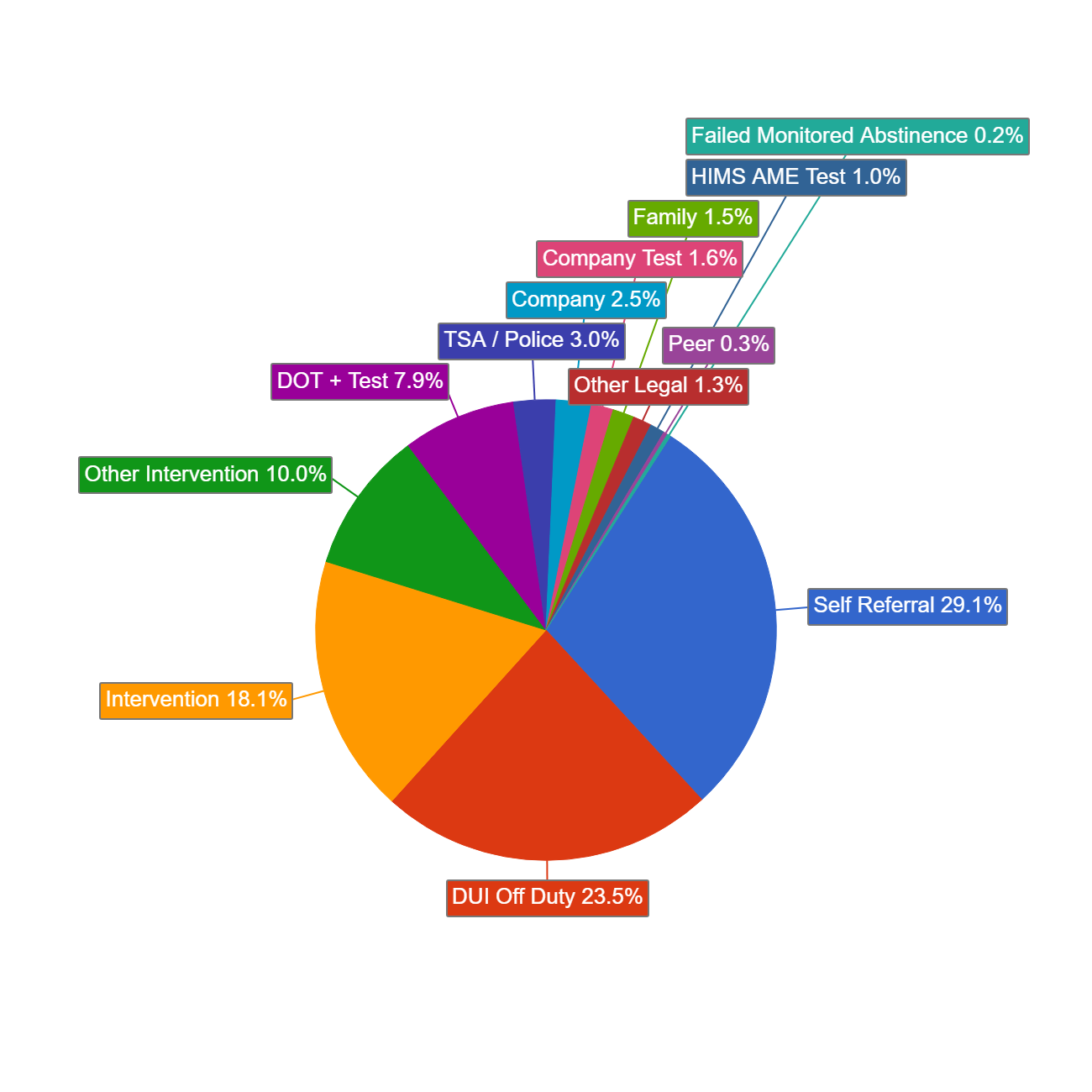
How Entered Program (Incidents)
Discovery | # | %
Self-referral | 600 | 29.1
DUI Off Duty | 485 | 23.5
Intervention | 374 | 18.1
Other Intervention | 206 | 10.0
DOT + Test | 164 | 7.9
TSA / Police | 61 | 3.0
Company/Test | 83 | 4.1
HIMS AME | 21 | 1.0
Family | 31 | 1.5
Peer | 6 | 0.3
Failed M.A. | 5 | 0.2

Slide 70
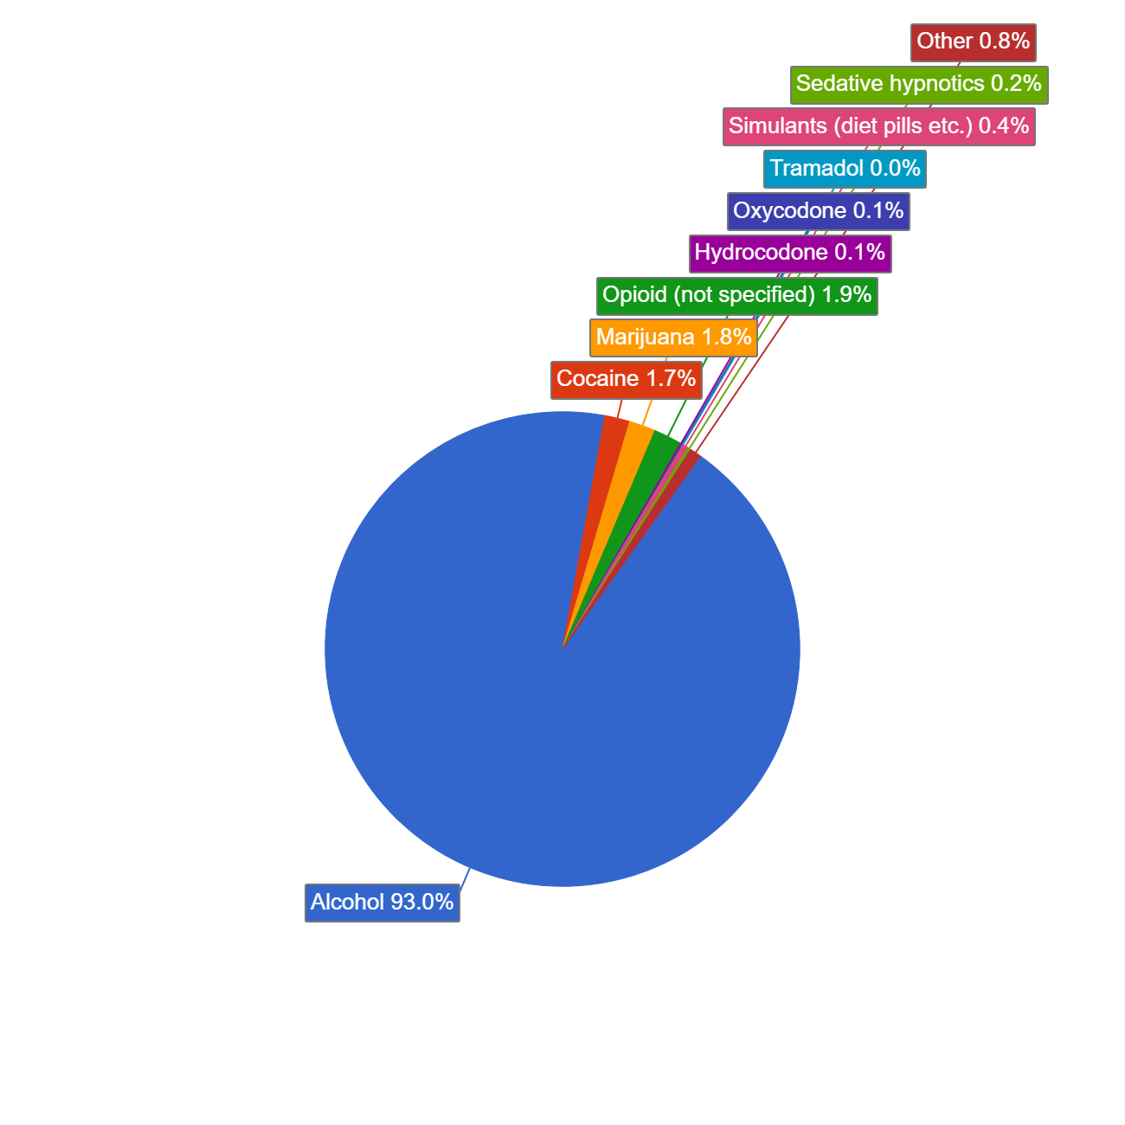
Drug of Choice
Primary DOC 1,469 Pilots | #’s | %
Alcohol | 1376 | .8
Opioid/Opiate | 30 | 2.1
Cocaine | 25 | 1.7
THC | 27 | 1.8
Stimulants | 6 | 0.4
Sedative Hypnotics | 3 | 0.2
Other | 12 | 0.8

Slide 71
Relapse Detection Data - Incidents
Discovery | EtOH | Cocaine | MJ | Opioid | Rx Narc | Sedat Hypnot | Stim Meth
Intervene | 132 | 1 | 0 | 4 | 1 | 0 | 0
+ DOT Test | 33 | 4 | 3 | 6 | 1 | 0 | 1
Off Duty | 7 | 0 | 0 | 3 | 0 | 0 | 0
Self Report | 133 | 2 | 0 | 11 | 0 | 1 | 1
TSA/Crew | 12 | 0 | 0 | 0 | 0 | 0 | 0
DUI | 113 | 0 | 0 | 3 | 1 | 0 | 0
Company | 21 | 0 | 0 | 0 | 0 | 0 | 0
AME Test | 17 | 0 | 0 | 0 | 0 | 0 | 0
Failed M.A. | 1 | 0 | 0 | 0 | 0 | 0 | 0

Slide 72
Relapse Rate by Drug of Choice
Drug of Choice | Relapse Rate
Alcohol | 13.1 %
Cocaine | 16.0 %
Cannabis | 7.4 %
Opioids | 39.3 %
Stimulants | 0.0 %
Sedative Hypnotics | 0.0 %
Other | 8.3 %
Total | 13.4%

Slide 73
FAA Special Issuances – Drugs, Alcohol & SSRI’s
Diagnosis | 1st | 2nd | 3rd | Total
Alcohol Abuse & dependence | 2,921 1.15% | 991 0.93% | 1,129 0.58% | 4,961 0.91%
Drug Abuse & Dependence | 1,413 0.55% | 481 0.49% | 637 0.33% | 2,531 0.46%
Alcohol / Drug Monitored | 2,050 0.80% | 232 0.24% | 289 0.15% | 2,571 0.47%
Alcohol related offense | 12,099 4.75% | 5,902 6.02% | 9,380 4.84% | 27,381 5.01%
Drug related Offense/misuse | 948 0.37% | 502 0.51% | 742 0.38% | 2,192 0.40%
SSRI | 398 0.16% | 96 0.10% | 414 0.21% | 908 0.17%
SSRI Special Issuance | 232 0.09% | 25 0.02% | 132 0.07% | 389 (296) 0.07%
Source: DOT/FAA/AAM-22/4 “2020 Aerospace Medical Certification Statistical Handbook”, April 2022; Page 32

Slide 76
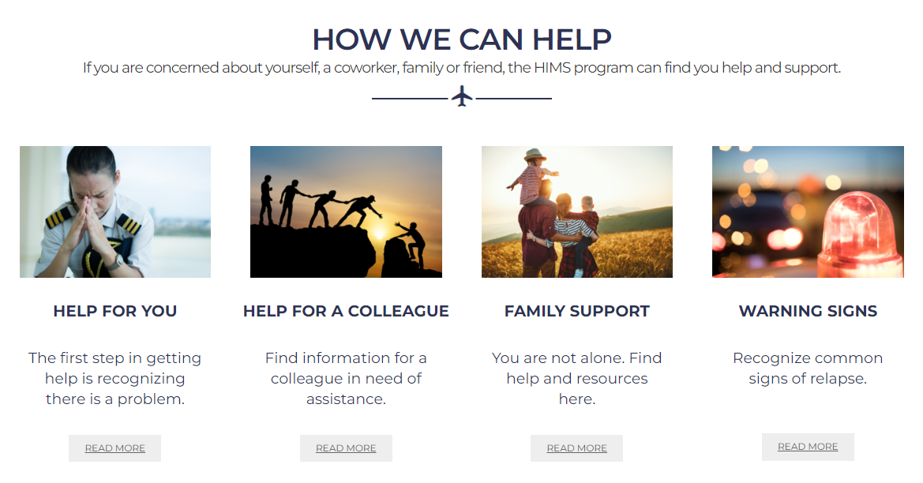

Slide 77
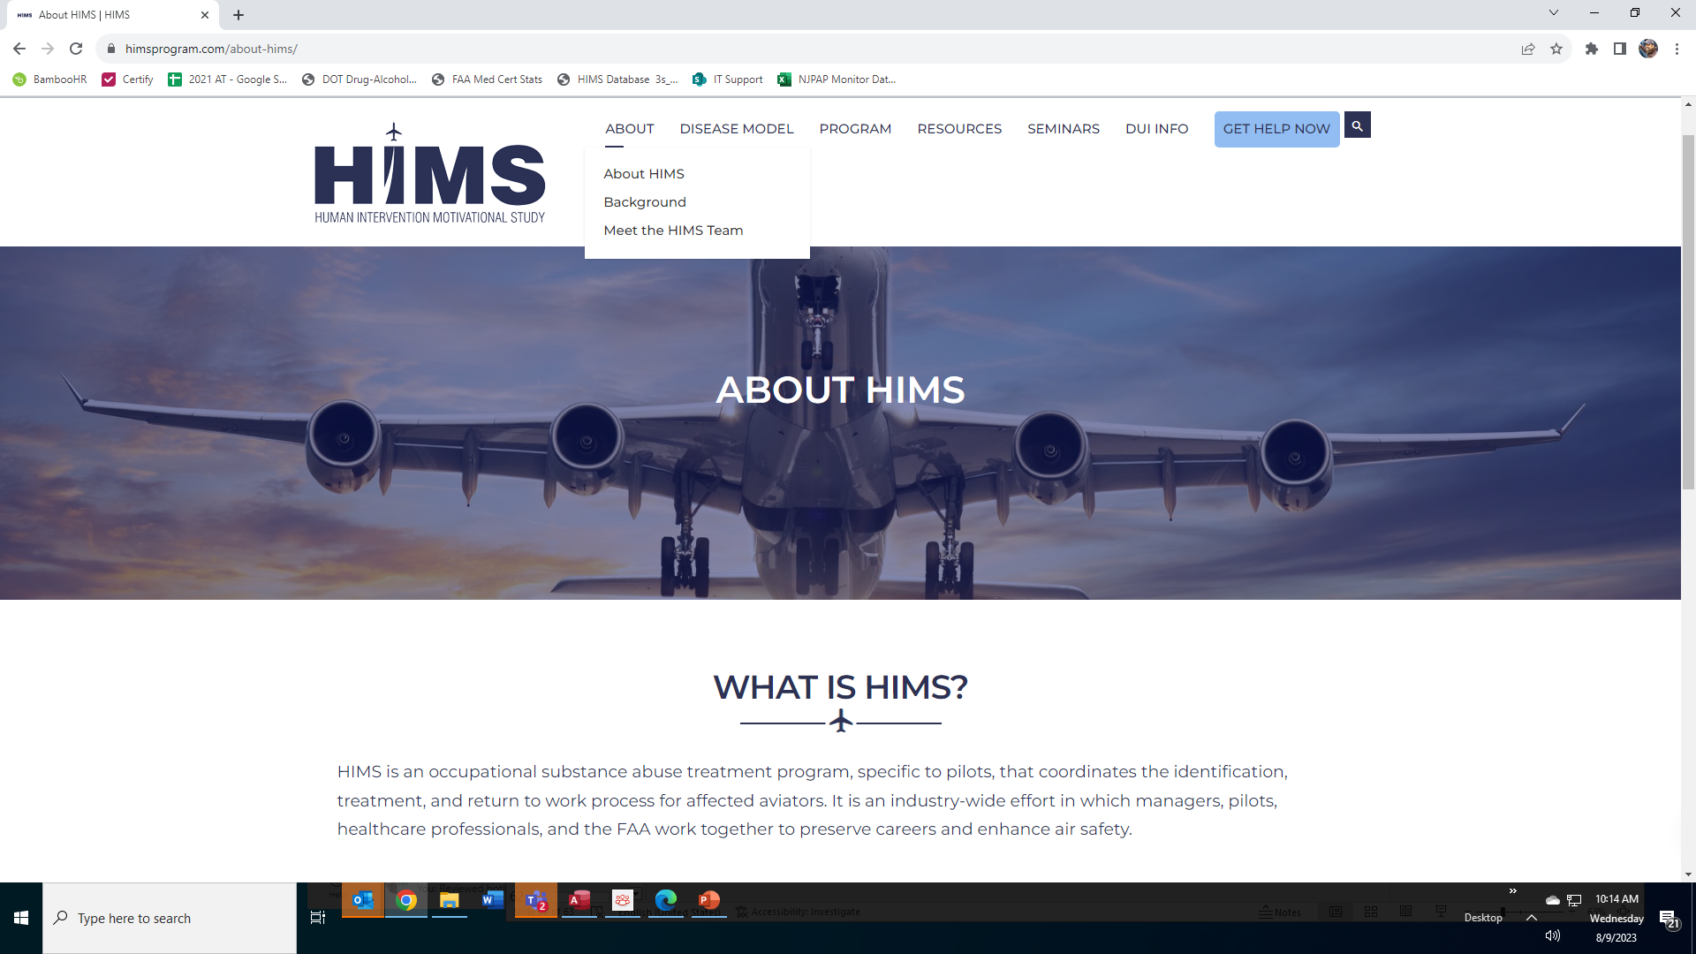

Slide 78
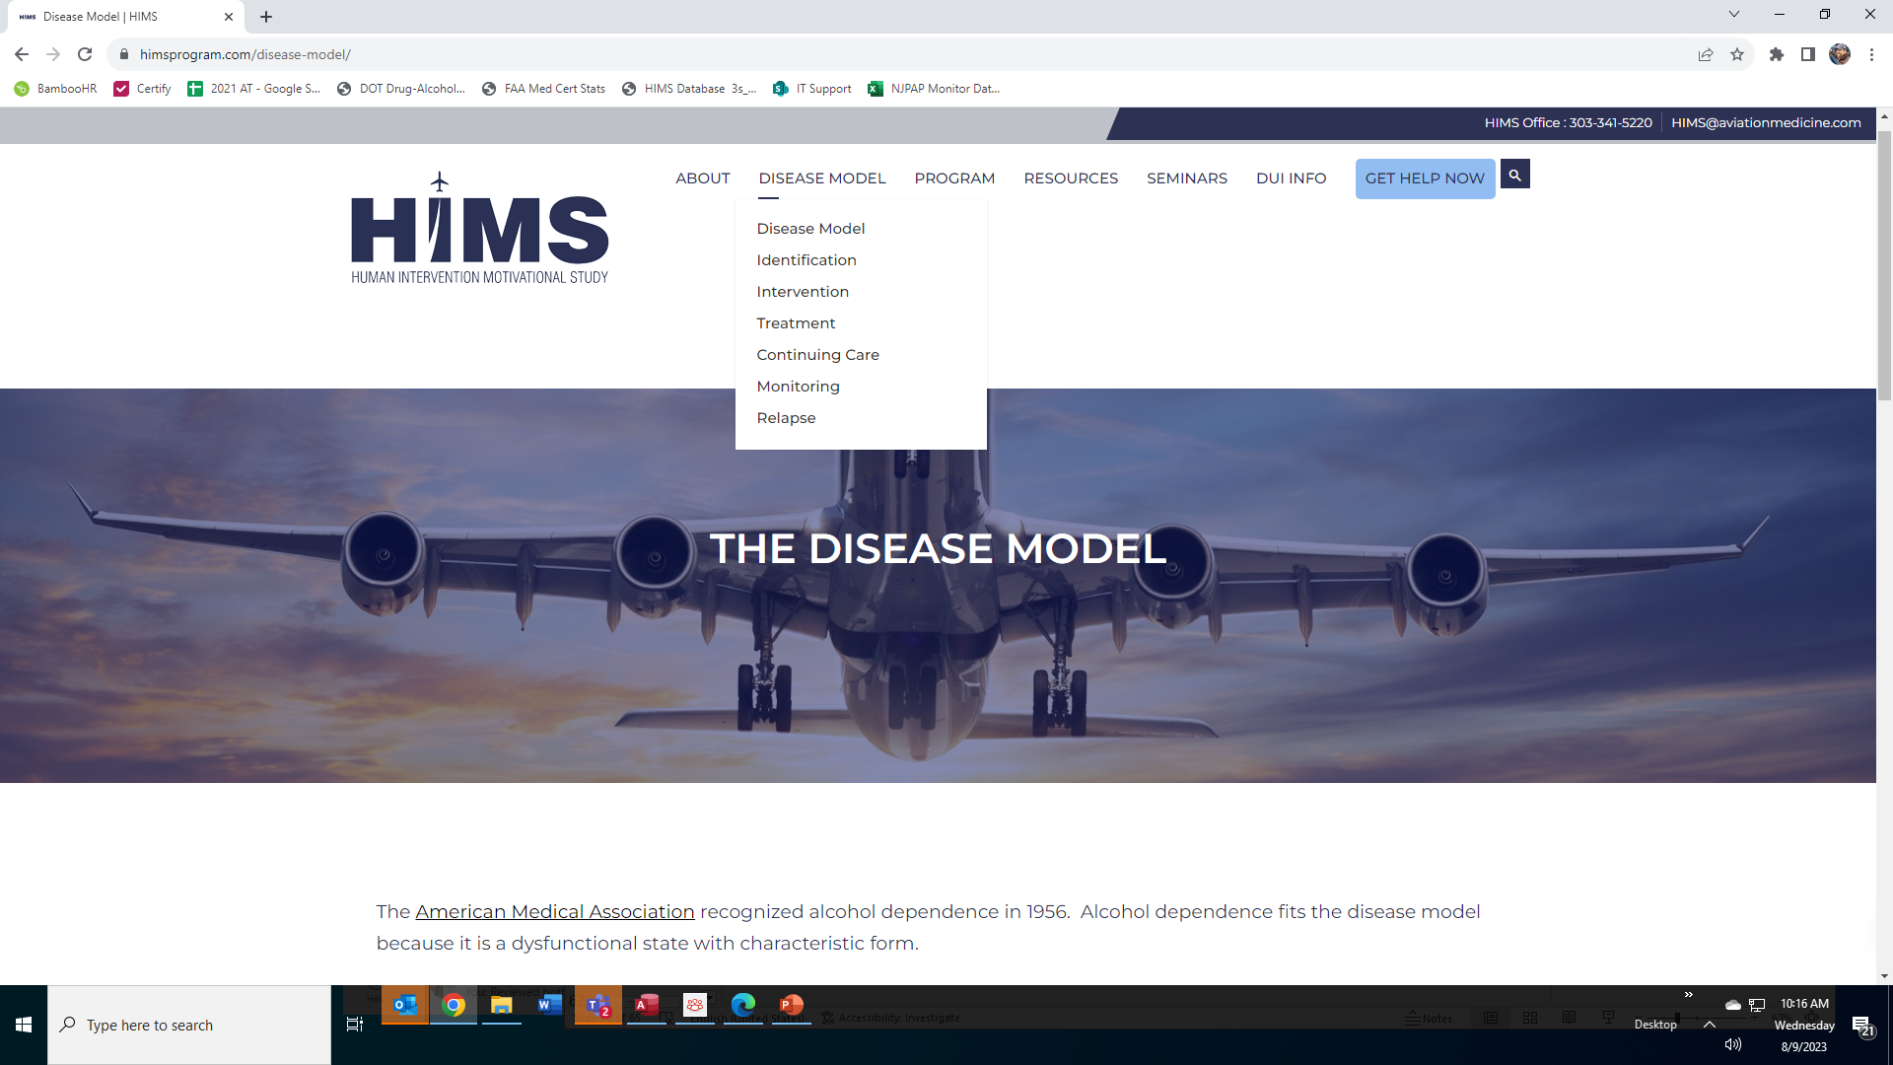

Slide 79
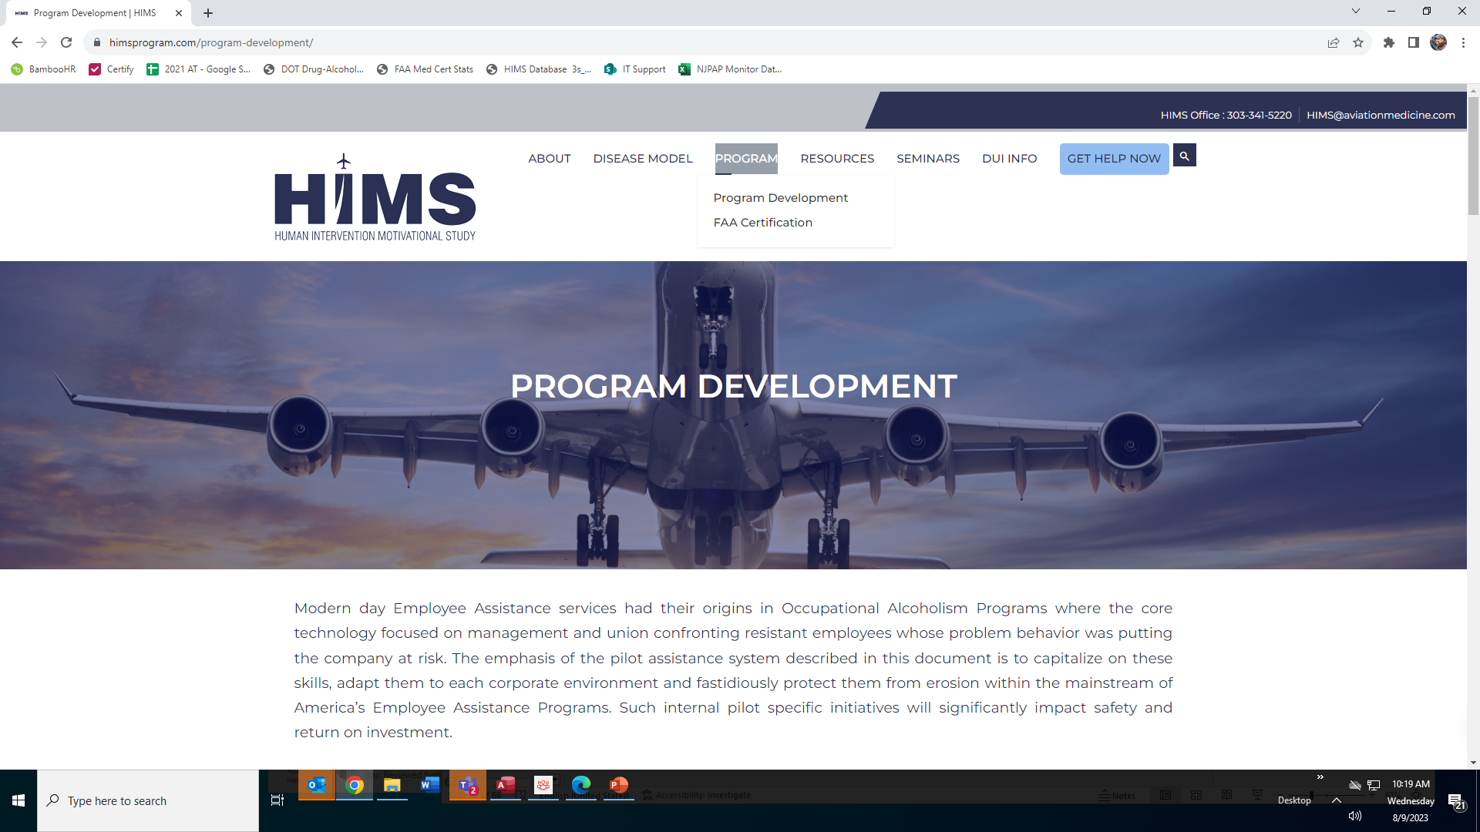

Slide 80
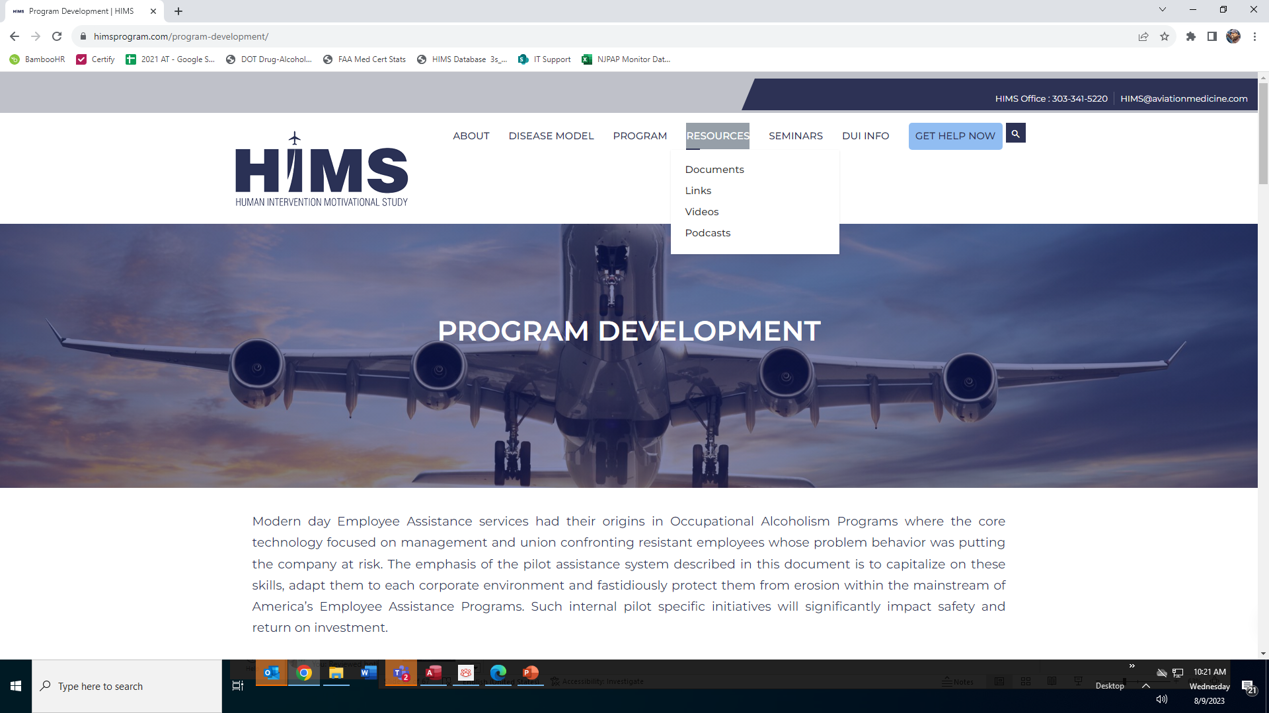

Slide 81
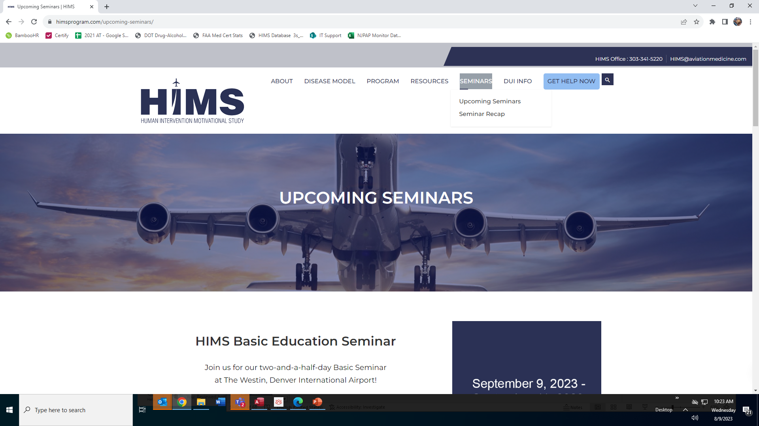

Slide 82
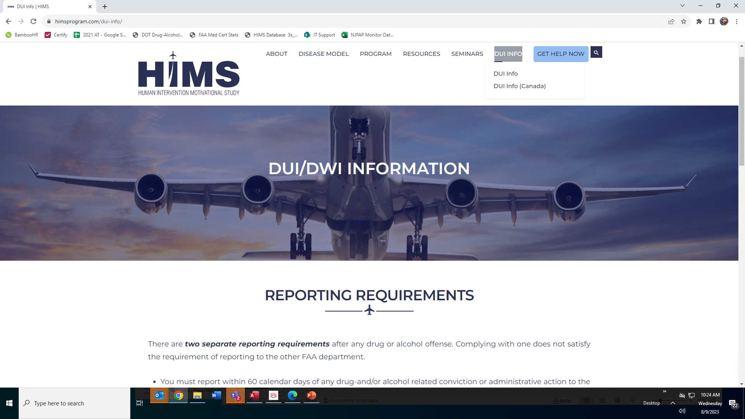

Slide 83
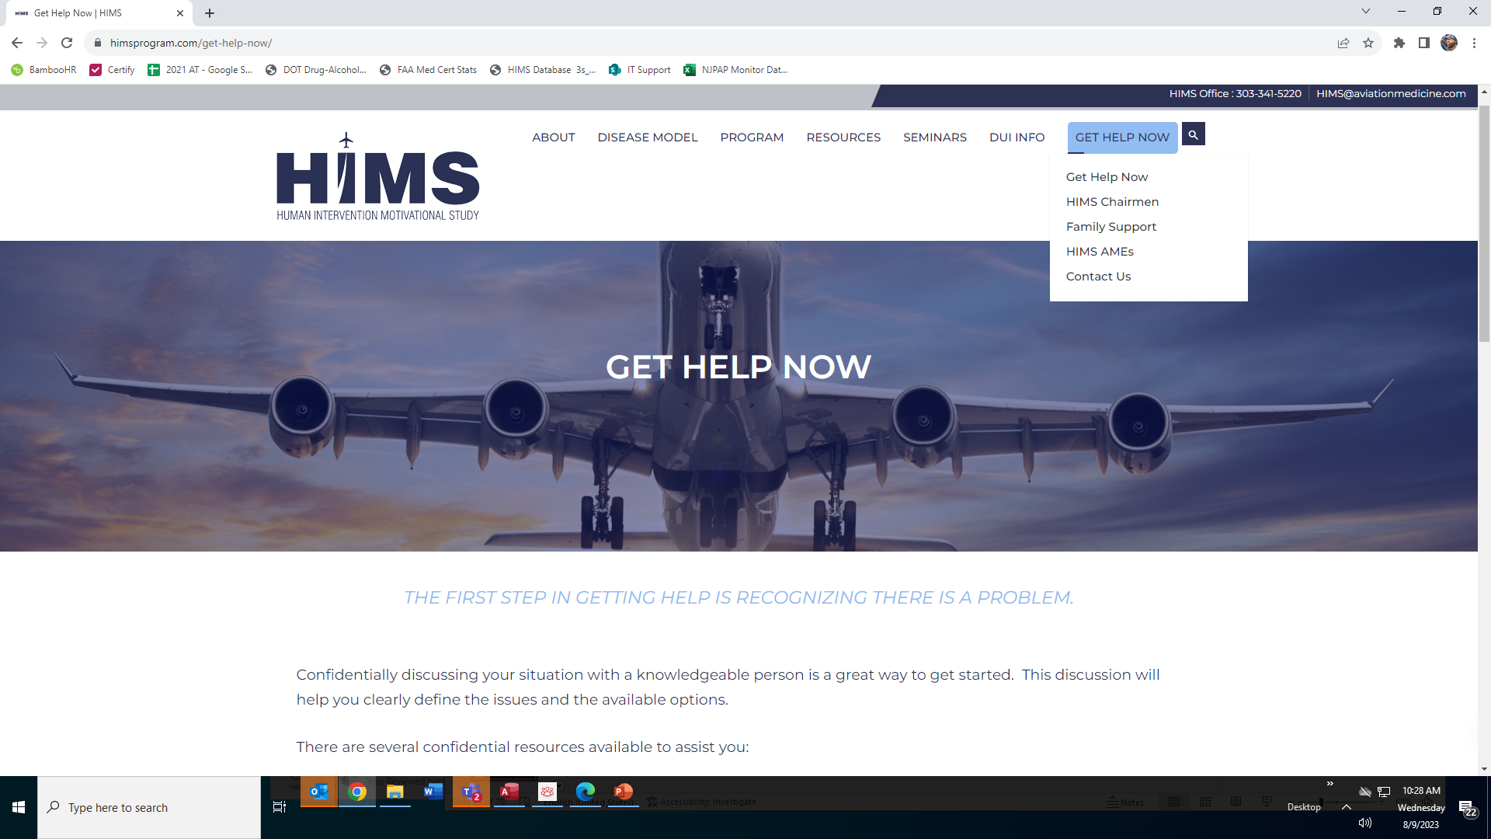

Slide 84
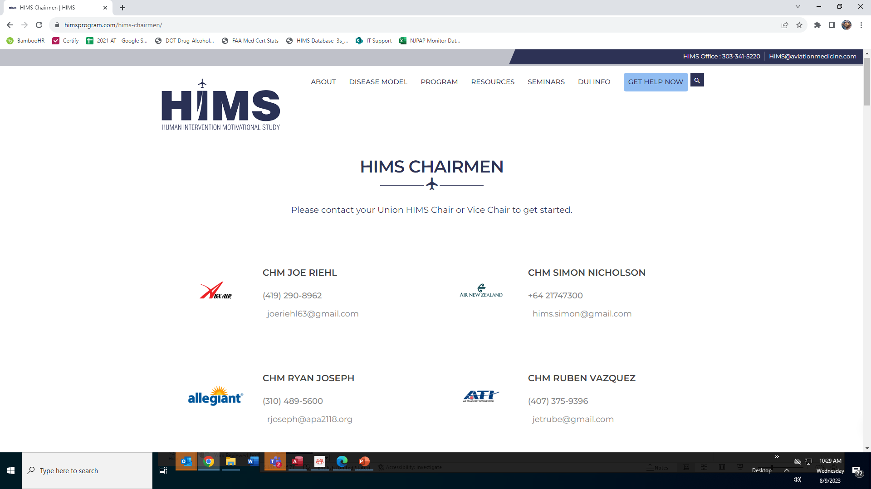

Slide 86
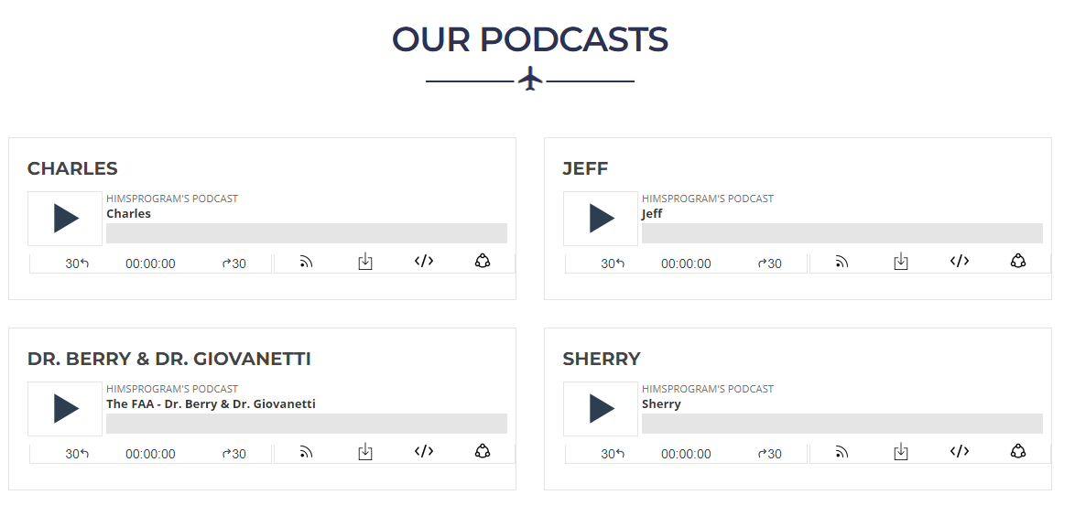

Slide 87
Questions??
FO Craig Ohmsieder
ALPA Int’l HIMS Chairman
craig.ohmseider@alpa.org
(770) 519-5407
Capt. Billy Petersen
ALPA Int’l HIMS Vice Chairman
516-818-8495 william.petersen@alpa.org
Dr. Quay Snyder
ALPA Aeromedical HIMS Program Manager
HIMS@aviationmedicine.com
(303) 341-4435 (AMAS)
www.himsprogram.com

Slide 88
Aviation Family Fund
Dana C. Archibald

Slide 89
“My superpower is staying sober.”
Image by Sunny Daye from Pixabay

Slide 90
What is the Aviation Family Fund?
AFF assists in providing supplemental funding during the recovery process for alcohol and drug-related dependence, and mental health issues. We are available to anyone in the aviation industry.
2023 Basic Education Seminar HIMS Program – Introduction to Basics
3

Slide 91
Overview
AFF created 2011
Since AFF’s inception, over $825K granted!
IRS approved 501©3 nonprofit
All donations are 100% tax deductible
In 2021, AFF helped over 70 people with financial assistance
Provided referrals, information and advice to several hundred people in 2021
2023 Basic Education Seminar HIMS Program – Introduction to Basics
4

Slide 92
Overview
Of all monies received, 95% went to approved applicants
No money is issued directly to the approved applicant
Money is issued directly to institutions
The average grant is between $1500-$2500
2023 Basic Education Seminar HIMS Program – Introduction to Basics
5

Slide 93
COVID-19 Impacts
According to the Centers for Disease Control and Prevention, as of June 2020, 13% of Americans reported starting or increasing substance use as a way of coping with stress or emotions related to COVID-19. Overdoses have also spiked since the onset of the pandemic. A reporting system called OD-MAP shows that the early months of the pandemic brought an 18% increase nationwide in overdoses compared with those same months in 2019. The trend has continued throughout 2020, according to the American Medical Association, which reported in December that more than 40 U.S. states have seen increases in opioid-related mortality along with ongoing concerns for those with substance use disorders.
Source: American Psychological Association, March 2021
2023 Basic Education Seminar HIMS Program – Introduction to Basics
6
93

Slide 94
What Do We Pay For?
Inpatient
Outpatient
Aftercare
COBRA
Rent
Electric
Mortgage
Water bill
Doctor bills, (AME, P&P Certificates, etc.)
Soberlink
~ We will not provide funding for luxury items ~
2023 Basic Education Seminar HIMS Program – Introduction to Basics
7

Slide 95
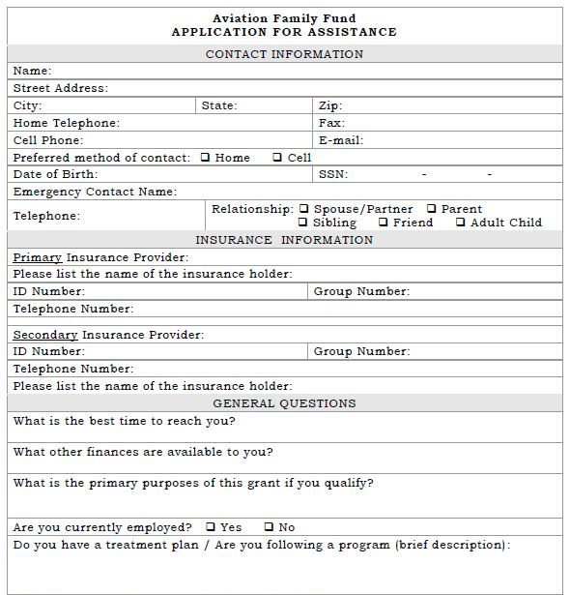
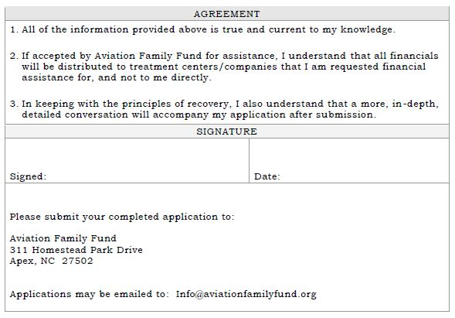
How Does Someone Apply?
2023 Basic Education Seminar HIMS Program – Introduction to Basics
8

Slide 96
Succession
Aviation
School
First
Officer
Captain
Instructor
2023 Basic Education Seminar HIMS Program – Introduction to Basics
9

Slide 97
How Does One Donate?
Monthly, through your bank’s bill pay
Personal or business check mailed to the address on website
Stock Donations
Source: https://www.freeiconspng.com/img/4125
Source: https://www.freeiconspng.com/img/6029
2023 Basic Education Seminar HIMS Program – Introduction to Basics
10

Slide 98
Source: https://www.iconsdb.com/red-icons/new-icon.html
2023 Basic Education Seminar HIMS Program – Introduction to Basics
11

Slide 99
Other Kinds of Donations
In-Kind Donations
Providers may offer discounted fees off of standard charges for evaluations and services; tax receipts are sent for all donations and in-kind donations
Providers may limit the number of discounted cases, or receive referrals, or continue to receive referrals (for existing providers)
For documentation purposes, we can provide our tax ID number. This can be for P&P, HIMS, after care, AME, etc.
Source: https://www.freeiconspng.com/img/27490
2023 Basic Education Seminar HIMS Program – Introduction to Basics
12

Slide 100
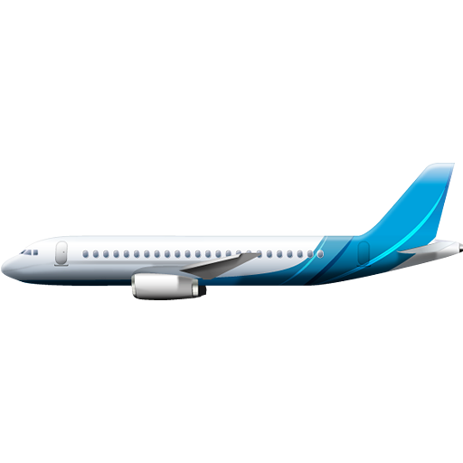
Airline Donations
Source: https://www.freeiconspng.com/img/2495
2023 Basic Education Seminar HIMS Program – Introduction to Basics
13

Slide 101
In Conclusion
Aviation Family Fund is a true Nonprofit
NO salaries
NO expense accounts
NO corporate jet
Quickbooks & professional accountant services only
2023 Basic Education Seminar HIMS Program – Introduction to Basics
14

Slide 102
Questions?
Contact Information:
aviationfamilyfund.org
Dana Archibald, NCAC-1, SAP, LAP-C
President
(919)-608-1735
2023 Basic Education Seminar HIMS Program – Introduction to Basics
15

Slide 103
HIMS Psychiatric and Psychological Evaluation
Paul Sargent M.D., FAPA Psychiatry, Brain Injury Medicine Dan DaSilva, Ph.D. Aviation and Pediatric Neuropsychology

Slide 104
Learning Objectives
Developing a collaborative approach to evaluation / consultation.
Improved familiarity / FAA guidelines; 14CFR67.
Differences between DSM-IV, DSM 5, and 14CFR67 in diagnoses.
“Rules of Engagement” for independent evaluations.
Gathering collateral history and evidence to support conclusions.
Evaluating the quality of a recovery program and risk for relapse.
Developing an effective plan for follow up and monitoring.

Slide 105
The Role of the HIMS Psychiatrist
Eyes, Ears, Critical Thinking all engaged.
Independent stance. Not advocacy.
Knowledge of psychopathology, prognostics,
and regulations. Ability to integrate all 3.
Conducting both initial SUD and/or P&P.
Part of TEAM which includes Neuropsychologist, AME, Aftercare provider, and FAA SME.
Disagreements are best handled verbally before doing so in writing. Team has the SAME GOAL…..SAFETY!
Image by Mohamed Hassan from Pixabay

Slide 106
Introductory Case - SUD referral
61 YO Single, Caucasian male seeking 3rd Class Medical.
Age 18-23. 8-10 beers. Weekends only. Army. Honorable discharge.
Age 24-27. Binge drinking while in college. 6-8 beers, 4 days per week. No blackouts. No problem with relationships or academic performance. Graduated on time with 2.9 GPA.
Age 27-49 Collegiate sports coach. Drinking limited Weekends only.

Slide 107
Introductory Case - SUD referral … (Cont’d)
Age 49-54. After 3rd DUI had 5 years of sobriety/ abstinence. Court incentivized program.
3 DUIs. Age 33 (BAC 0.1%) Age 38 (BAC 0.1%), Age 49 (0.19%).
Last DUI occurred after an MVA in which he was driving with open container but the OTHER driver ran a red light and hit him. Poor insight into his role…
Currently 2 Light beers, twice per month x 6 years

Slide 108
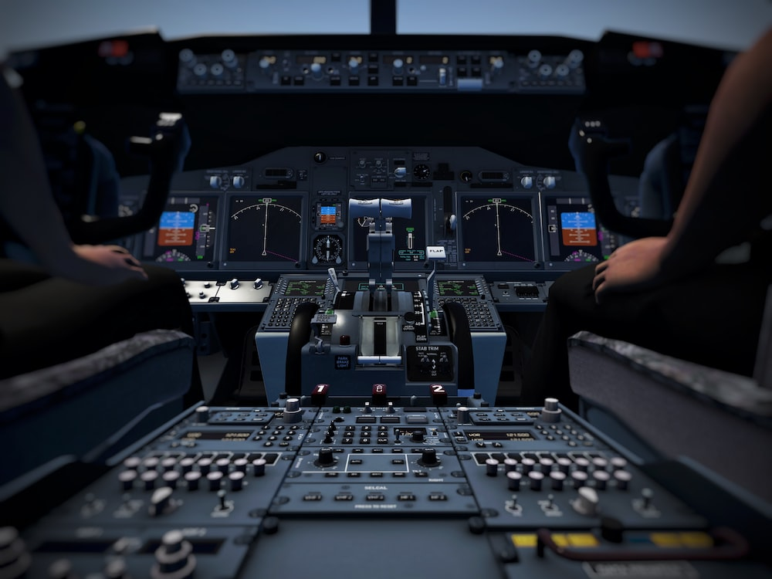
What’s the Correct Diagnosis?
Photo by Taiki Ishikawa on Unsplash

Slide 109
FAA Medical Standards 14 CFR 67.107/ .207/ .307- Mental
No medical history or clinical diagnosis of any of the following:
Personality Disorder “repeated overt acts”
Psychosis
Bipolar Disorder
Substance Dependence (unless 2 yrs. of sobriety)
No other personality disorder, neurosis, or other mental condition that may make the person unable to safely perform the duties of an airman.
Substance Abuse within the last 2 years.

Slide 110
Broad Definition of Substance Abuse
Repeated use of a substance in a physically hazardous situation
Positive DOT test for drug or alcohol (BAC 0.04%)
Misuse of a substance which the Federal Air Surgeon finds make the user unable to safely perform the duties of an airman, or may reasonably be expected to make the person unable to perform those duties in the future.

Slide 111
Disambiguation of Classification Systems

Slide 112
“Rules of Engagement” for an Independent Evaluation
Be candid right up front. Verbally AND in in writing.
There is no “Treatment Relationship,” confidentiality modified.
Regardless of who pays the bill, you do not work for the client.
You also do not technically work for the FAA.
Your job is to gather information, understand the situation, and apply FAA criteria, The FAA will make the disposition.
Any information revealed in records, interview, or by collateral sources then it will be in the report.
Image by Mohamed Hassan from Pixabay

Slide 113
Tips to Interview a Potentially Defensive Client.
Be affable and warm.
Plan for a long appt. 90 min?
Remind them that FAA makes final decisions. Not you.
Invite them to tell their own story.
Use reflective statements, open ended questions.
Once you have all the basic info, circle back with some probing questions, later, if needed, offer challenging observations.
Asking a series of closed ended questions increases defensiveness.

Slide 114
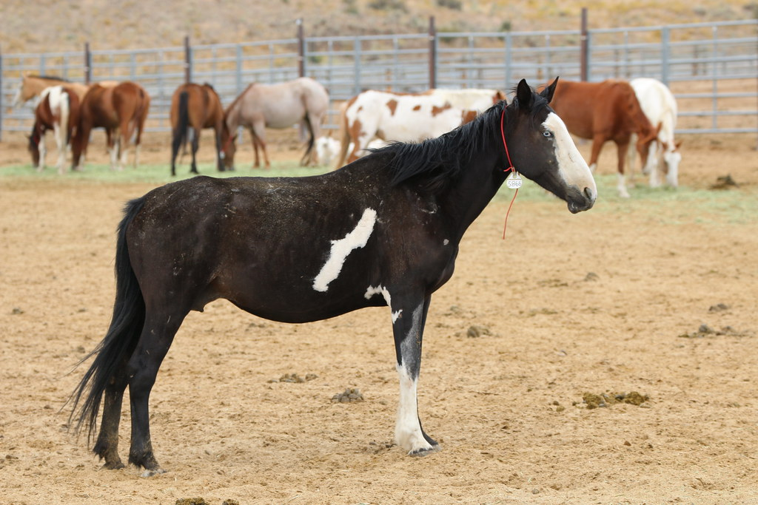
You learn more about a horse if you let it run around the corral than if you watch it in the stall.
This Photo by Unknown Author is licensed under CC BY

Slide 115
Gathering Collateral History and Evidence
Have client request FAA records BEFORE you schedule the appointment.
Be prepared to review and store large files of paper. But electronic is now an option!
Get police reports or ER records if BAC not documented in FAA record.
Get releases of information up front, usually eliciting information more than providing it.
Information gathering and documentation must be comprehensive and will likely take several hours.
Image by GraphicMama-team from Pixabay

Slide 116
Gathering Collateral History and Evidence (Cont’d)
What does COMPREHENSIVE Collateral history mean?
The FAA
Their AME
Their Neuropsychologist
Their Aftercare Provider
Their psychotherapist and/or treating psychiatrist
Their supervisor
Their sponsor
Their spouse, partner, or ex-spouse
Their CFI or someone who has flown with them
Their union representative
Any friends or co-workers

Slide 117
Evaluating QUALITY of recovery program. Identifying risk for relapse.
Strong in sobriety ≠ Working a strong program
Acceptance of the disorder
90/90 followed by 3-5 meetings per week x 1 year (Established home group)
Active engagement with sponsor, working 12 steps.
Active stress management program

Slide 118
Evaluating QUALITY of recovery program. Identifying risk for relapse.
In addition to a strong program, the airman must continue to have a “Monitored Recovery”
FACTORS WHICH AFFECT RISK FOR RELAPSE
Past relapses, Compulsive behaviors, co-morbid psychiatric disorders, Life Stressors, non-acceptance of diagnosis, lack of “bonding” with 12 step program.

Slide 119
S.T.R.O.N.G. P.R.O.G.R.A.M.
Sponsor
Three Mtgs./wk.
Reading the Book/ Working the Steps
OWN IT!
Ninety in Ninety
Group (Home)
Professional/ Recovery balanced
Resentments (dealing with)
Outlets (fitness/ hobbies)
Growth Mindset
Relationships
Aftercare
Monitoring

Slide 120
A collaborative approach to include consultation with FAA SMEs.
Do not be afraid to consult with an experienced colleague
Do not be afraid to consult with an FAA SME
This never ends no matter how senior you become.
Image by kdbcms from Pixabay

Slide 121
Report Writing
Forensic Quality. Typically takes several hours to write.
Write like you expect it will be reviewed in a hearing, and that you may be called upon to defend your position.
Expect that it will be reviewed by other Subject Matter Experts who will disagree with some aspect of your assessment.

Slide 122
Report Writing (Cont’d)
Utilize clear language and FAA criteria for diagnosis.
Write from the perspective of maintaining aviation safety.
Do I want to have this airman flying in the airspace around myself and my family?

Slide 123
Cross Check Report Prior to Submission
HAVE I CLEARLY…..?
Made or confirmed a clinical diagnosis for the FAA?
Ruled out any disqualifying psychiatric conditions?
Assessed the quality of the airman’s recovery program?
Maintained a neutral stance with respect to advocacy, and accurately presented the airman’s areas of strength and risk?
Image by VideoPlasty.com from Pixabay

Slide 124
Cross Check Report Prior to Submission (Cont’d)
HAVE I CLEARLY…..?
Addressed rule out conditions which would be disqualifying (Psychosis, suicidal ideation, ECT treatment, need for multiple medications)
Made all appropriate recommendations for additional treatments and monitoring issues?
Couples Therapy, individual therapy, need for further labs or testing, need for medication.
Image by VideoPlasty.com from Pixabay

Slide 125
Follow Up Planning
Recommend a follow up schedule, but FAA will determine what is required.
May be annually, may be up to 4 times per year.
Clients often “forget” when they are supposed to follow up.
Some may see that as “lack of investment” on their part, however, I recommend you maintain a system which allows you to reach out and remind them in a timely manner.

Slide 126
Please save your questions until after Dr. Dan…
Image by Mohamed Hassan from Pixabay

Slide 127
Purpose of the Neuropsychological Evaluation
Primarily, to assess for aero medically significant neurocognitive deficits secondary to substance abuse.
Alcoholism affects brain functioning. Important to be aware of those functions most sensitive to the impact of chronic/sustained substance abuse.
Assess quality of recovery program/investment in recovery.

Slide 128
Demands may differ but the standards are the same…

Slide 129
NOT an assessment of airman proficiency.
Proficiency as a pilot is assumed based on their certificates and flight time.
Part 67 of FAR’s addresses medical eligibility with criteria that apply regardless of flight hours or aircraft type.

Slide 130
Alcohol damages frontal/limbic systems
Extent varies from individual to individual
In most cases, the damage is reversible
The deficits we see are consistent with the “reversible” concept.

Slide 131
Alcohol-related Impairments
Executive Functioning
Cognitive Flexibility
Deductive Reasoning
Memory
Learning
Recall
Visuospatial abilities

Slide 132
In the course of the evaluation, incidental findings may become apparent.
If aero medically significant or disqualifying conditions are uncovered, they cannot be ignored.

Slide 133
Why a Standardized Battery?
Establishes standardization
Essential domains are always assessed
Regardless of where the evaluation is performed and regardless of neuropsychologist, every pilot gets the same battery
Selection of valid tests that are sensitive to the alcohol-related deficits and the recovery
Facilitates determination by reviewer

Slide 134
Why a Standardized Battery?
Not following the standard battery...
Not seeing a HIMS trained neuropsychologist unfamiliar with the standards.
Loss of time and money!
Increases the likelihood that the report will be flagged by the FAA on initial review.

Slide 135
Cog Screen-AE (CSAE; Kay)
One hour computerized battery.
Unique as it is the only measure in the battery specifically designed for aviation.
Assesses the critical neurocognitive domains critical to aviation.
Established predictor of actual and simulated flight performance.

Slide 136
CSAE
Validated as sensitive to brain dysfunction including that attributable to alcohol use and its recovery.
Unique in its extensive normative data for both general aviation and commercial pilots.
Used by inpatient treatment facilities to assess
Severity of brain dysfunction
Need for cognitive rehab
Readiness for the P&P

Slide 137
Issues to Consider at the Time of Referral
Is the pilot ready?
At the time of initial contact…
Has the pilot been diagnosed (cart before the horse)?
Has the pilot been in treatment?
Is the pilot monitored/random drug/alcohol screens?

Slide 138
How Should the Pilot Prepare?
Work the Program
Rest
Proper nutrition
Exercise
Continued engagement in treatment and supports
Websites to practice cognitive tasks (Lumosity, Elevate, Happy Neuron etc.)
Anxiety reducer
Image by simisi1 from Pixabay

Slide 139
The day of the testing…
One day vs two days
Approximately seven hours of testing +/-
Style will differ from one examiner to the next
Psychologist should assess the pilot’s readiness for the assessment.
Proper rest?
Proper nutrition
Level of anxiety
Other distracting factors

Slide 140
Effects on testing results…
Lack of sufficient rest – Fatigue.
Anxiety – What is appropriate level, normal?
Similar to a normal check ride?
Learning disabilities, dyslexia, Etc.
Cultural, educational and language variations.

Slide 141
After the core battery…
Is there anything else that warrants follow-up, clinically?
Collateral Information (i.e. spouse, chief pilot).

Slide 142
What if there are issues?
Usually, need for more recovery time
For older (aging) pilots
For pilots with comorbidities
For pilots with more severe disease

Slide 143
What if there are issues?
Timeline for retest – Discretion of Neuropsychologist?
Cognitive Rehabilitation?
Healthy living!
Online and purchasable software (not proven but some efficacy shown in academic research).
Reduced anxiety and sense of increased control

Slide 144
Reduce anxiety!
Psychotherapy
Meditation
Clinical hypnosis

Slide 145
Questions?

